Slide 1
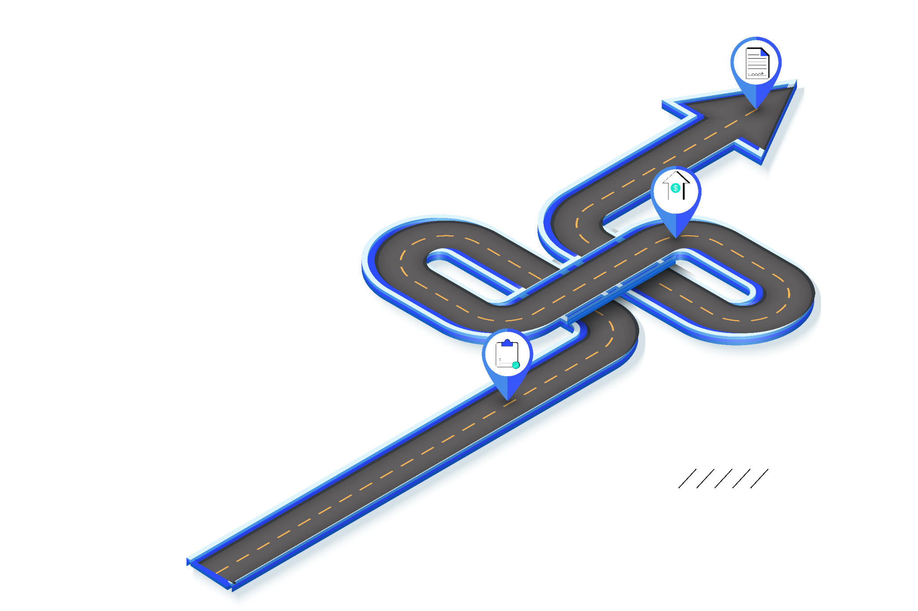
Roadmap

Slide 2
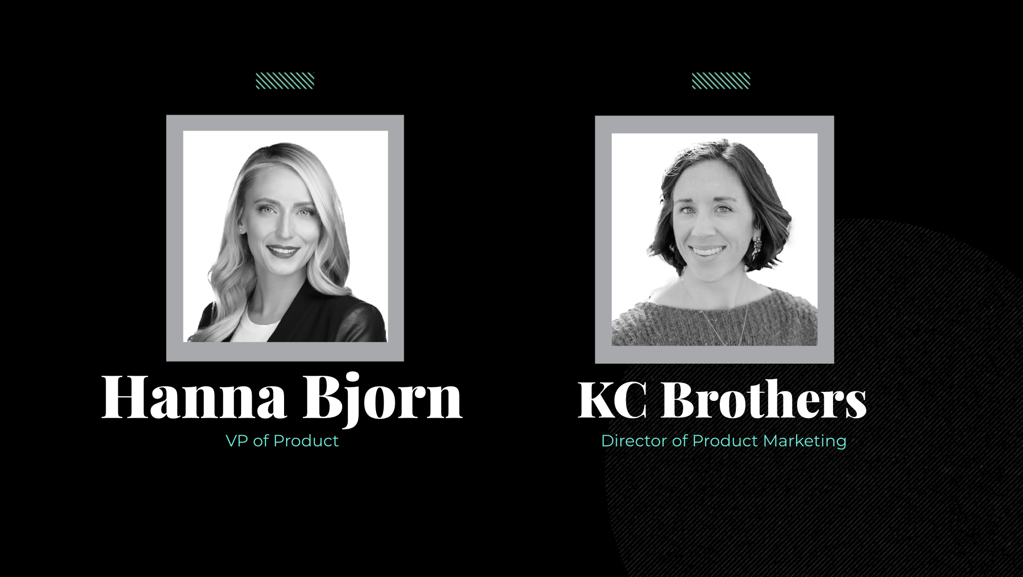
Hanna Bjorn
KC Brothers
VP of Product
Director of Product Marketing

Slide 3
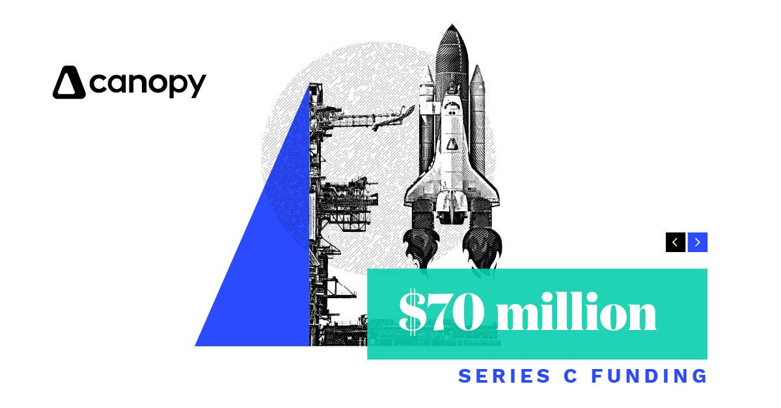

Slide 4
Canopy University Launch!
5 levels of certification to learn the depth and breadth of Canopy
2 modules available now

Slide 5
Last 6
month
recap

Slide 6
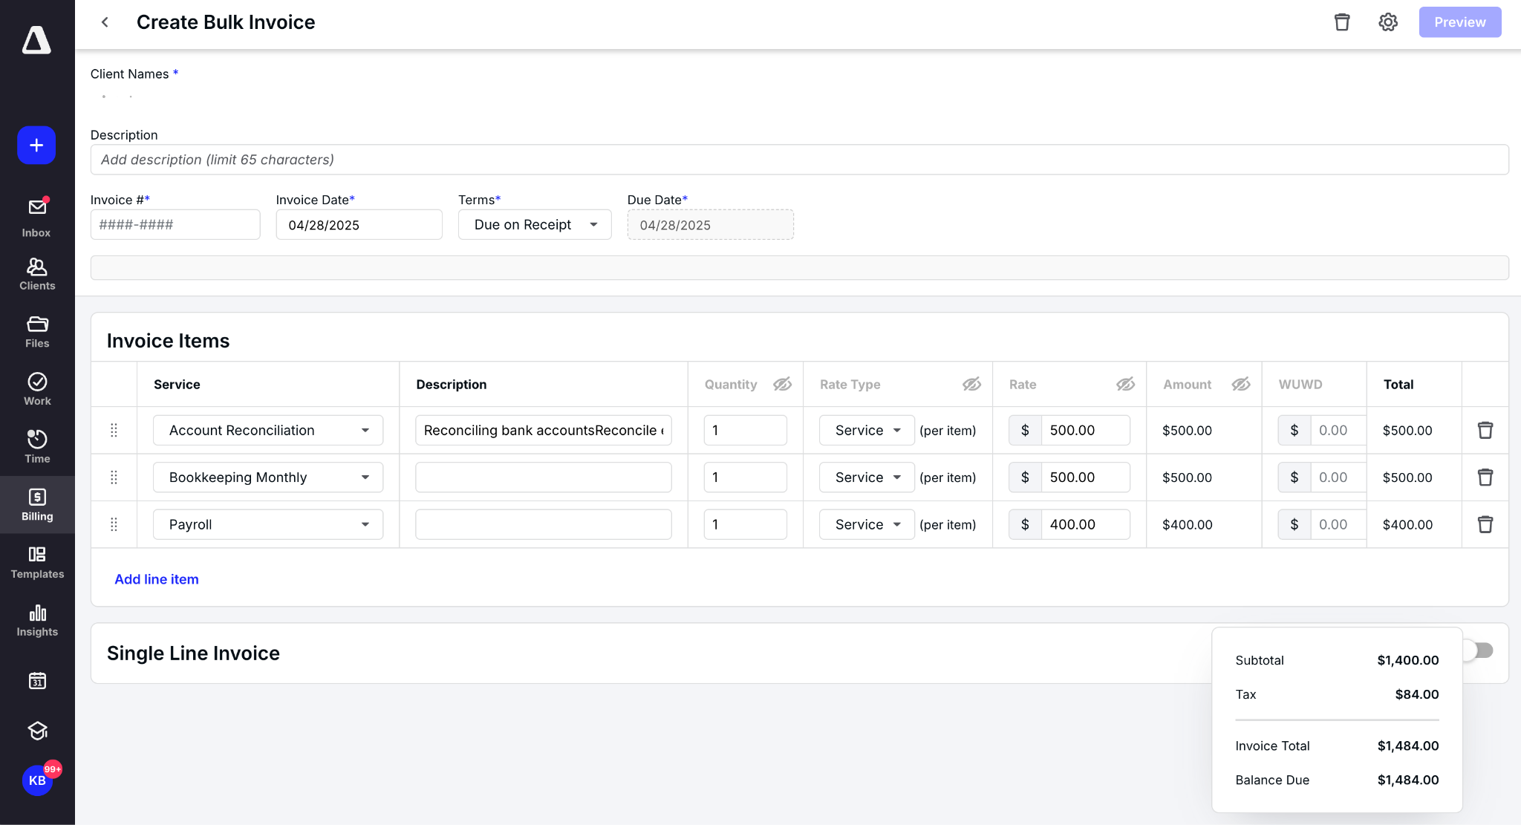
Bulk Invoicing
Create one, send to many
Ideal for flat rate billing
3 ways to build
Notes:
Hopefully you’re seeing a trend—to enable even greater scalability with a variety of bulk actions. Over the years, we’ve added many bulk capabilities to help you accelerate and streamline work. This one, Bulk Invoicing, streamlines the invoicing process. Simply create one invoice and blast it out to clients in one go. It’s ideal for flat-rate billing, and you have three different ways to handle them.

Slide 7
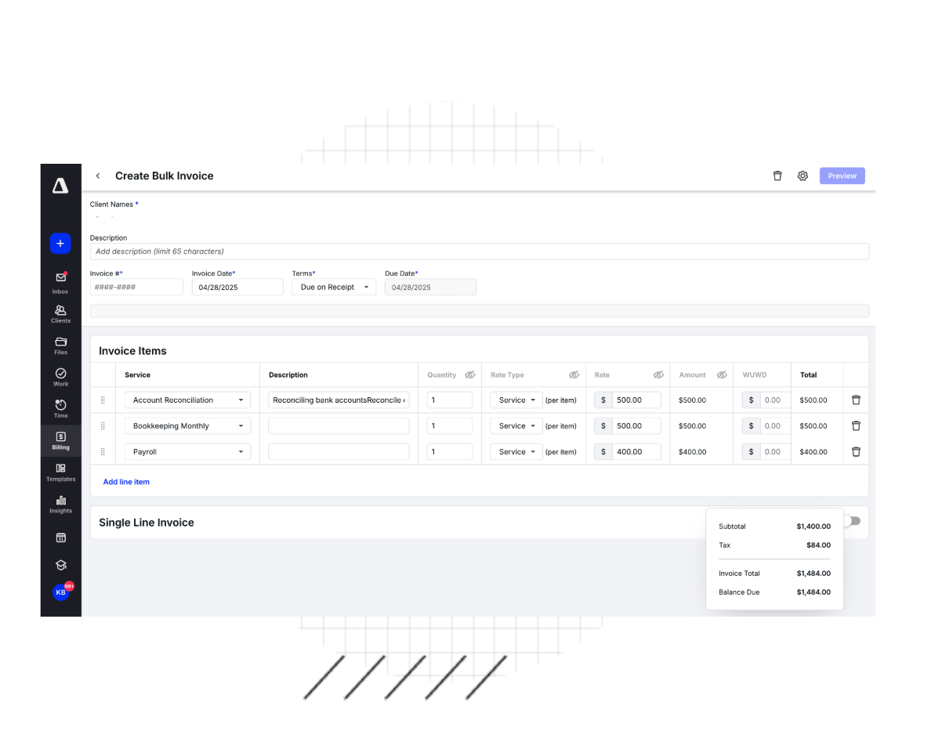
More Billing & Invoicing Improvements
Bulk Print Invoices
Partial Refunds
Custom Invoice Numbering
Required Time Entry Fields
Outstanding Balance
Locked Time Entries
Notes:
These updates help you manage time and billing with more speed, clarity, and fewer steps. We’re helping you make every minute and dollar count.
Instead of printing client invoices one at time, you can now select any client invoices and bulk print them—yes, all at once. Tada!
Firms sometimes issue partial refunds to their clients for goodwill or overages. We’ve now made it easier to part with your money. Sorry, but it doesn’t save you time, so there’s that.
You have your own client invoice sequencing, so now you can continue following it.
Practitioners sometimes omit important details—like client name, service, assignee, or related tasks—when adding time entries. Now you can mandate what fields are required.
Your clients have another way to see what they owe—front and center. The outstanding balance now appears on any invoice. This is another way we’re helping you provide more clarity, and most importantly, faster payments.
Time edits during payroll mess with billing and burn time fixing mistakes. Sometimes staff even tweak entries on the sly. This enhancement allows a practitioner to lock a time entry.

Slide 8
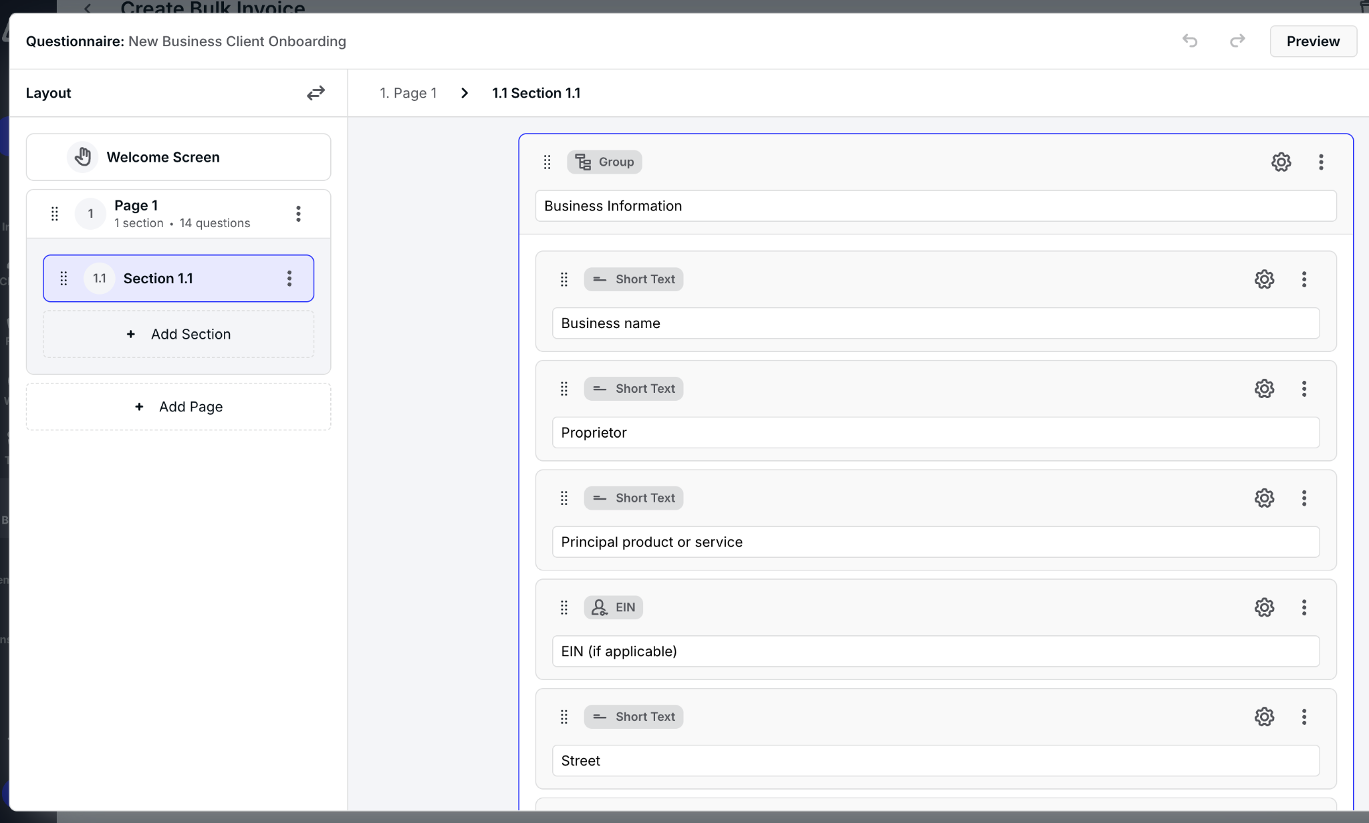
Questionnaires
New! Experimental Features
Customize
Templatize
Notes:
We are so thrilled with the adoption of this beta! We first released this Jan. 15 and then continued to add to it over the following months. For those of you who opted in, thank you for your adoption and feedback. This is the spirit of our product development at Canopy– customer driven and as fast as possible. We’ll be using this new in-app experience to manage open betas in the future, so be sure to come back. We will, of course, notify you as things are coming so you know exactly when to check.

Slide 9
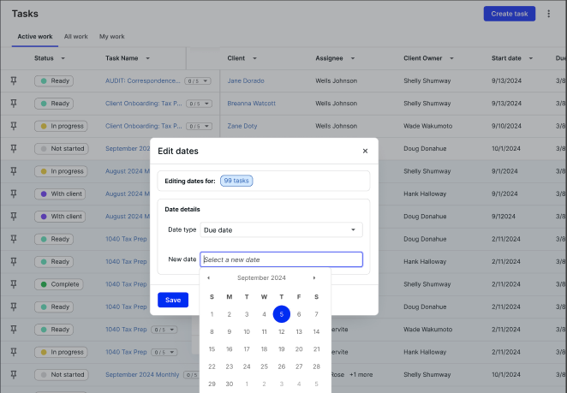
Task updates
Subtask Checklists
Bulk Date Change
Stop Automations on Completed Tasks
Stop Recurrences in Bulk
Permission to Edit Task Budgets
Notes:
We know that managing tasks isn’t just about checking boxes—it’s about keeping work flowing smoothly across the team. These enhancements are all about removing friction, so your work keeps moving ahead.
Subtask Checklists let you break tasks into smaller, trackable items. It’s great for keeping processes tight—so nothing slips through the cracks.
Bulk Date Change help you easily shift due dates across multiple tasks. It’s perfect for adjusting timelines when priorities shift fast.
Stop Automations on Completed Tasks stops automations from firing upon completion. No more unnecessary steps after you complete your work.
Stopping Recurrences in Bulk makes it faster, cleaner, and way less painful stopping tasks in batches.
And the new Permission to Edit Task Budgets lets you limit the people who can edit task budgets—so you have a clear picture of the budgeted work and actual work when you reach the end of a task.

Slide 10
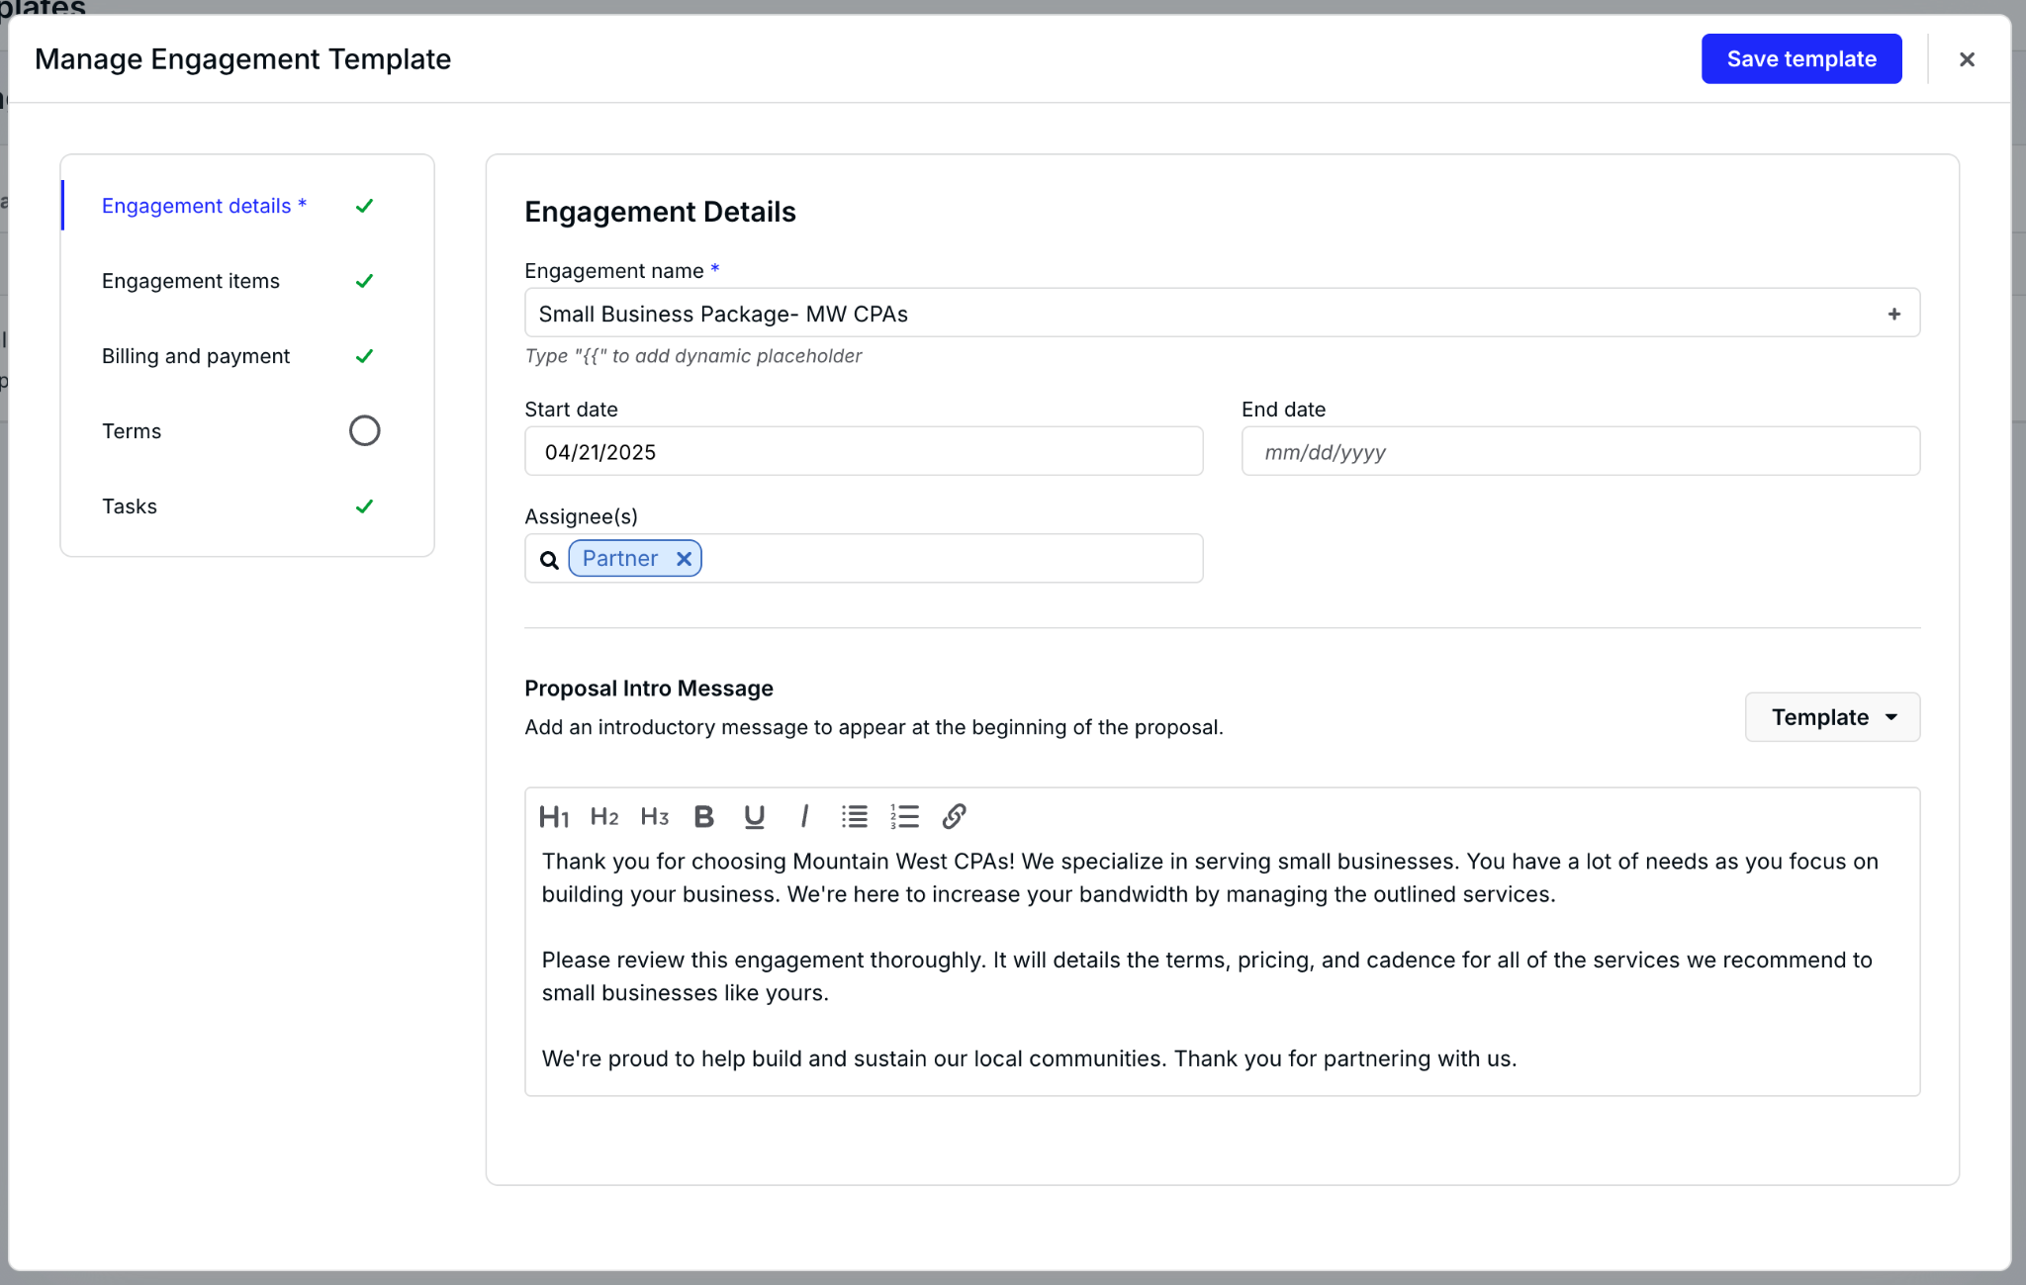
Engagements Improvements
Copy
Templates
Introduction
Bulk send
Notes:
We’ve made it easier to kick off engagements faster, stand out with a personal touch, and cut down the clicks it takes to get started.
Now you can jumpstart new engagements by copying an existing one or creating a template. Keep all the details—descriptions, services, pricing, acceptance tasks, whatever—to speed up the process of creating new engagements.
You don’t need to jump right into pricing and services! You can use the opportunity to highlight and differentiate your value with customizable intros to your engagement letters.
Creating and sending the same engagement letter to multiple clients is tedious and time-consuming. Sending drafted proposals one by one is also unnecessary now! This bulk-send enhancement accelerates the proposal-to-acceptance timeline.

Slide 11
Performance &
Uptime during
peak tax season
Notes:
“Let’s start with the obvious: April is not the month you want your software crashing. That’s like your calculator quitting on you in the middle of a tax return. We know how critical this season is—and we’re proud to say that Canopy held up like a champ. Peak usage, record logins, and no meltdowns. We’re talking serious performance under pressure. Over the next few slides, I’ll walk you through just how hard the platform—and our team—worked for you this tax season.”

Slide 12
99.99%
UPTIME
Notes:
“Alright, 99.99% uptime. Sounds fancy, right? Here’s what that really means: the system was up and running almost constantly—day and night. When you needed it, it was there. No spinny wheels, no 'we’ll be right back' messages. Just a platform that works when you do…which, let’s be honest, was probably 12 hours a day in April.”

Slide 13
2.5 Million
TASKS CREATED
11.8M SUBTASKS!
Notes:
“Over 2.5 million tasks and nearly 12 million subtasks. That’s… a lot of checkboxes. It shows two things: one, you’re incredibly organized. And two, Canopy can handle serious volume. This kind of scale proves that whether you’re planning for year-end or already gearing up for next season, you’re in good hands.”

Slide 14
10 Seconds
Median first response time for support chats
Notes:
“Tax deadlines don’t wait—and neither should you. Our median first response time on chat was just 10 seconds. That’s faster than it takes to open a new tab and Google your question. So when things got intense, we had your back. Fast, helpful support from actual humans. What a concept!”

Slide 15
30 Million
FILES UPLOADED
Notes:
“30 million files. That’s a digital mountain of 1099s, W-2s, receipts, and possibly a few accidentally uploaded cat photos. It’s all securely stored, totally accessible, and living in the cloud—so you can get to what you need, whenever and wherever you’re working.”

Slide 16
$523M
PAYMENTS
Notes:
In the last 12 months, nearly $523M have passed through Canopy Payments. That’s a lot of dough. Firms are adding our payment capabilities to simplify, expedite, and automate the payment collection process. https://mixpanel.com/s/4c0Dm8

Slide 17
250K
MOBILE APP DOWNLOADS
(4.9-star rating)
Notes:
Not to brag—well, not too much—but we’ve had 250 thousand downloads and installs of our client portal mobile app, and that number is growing every week. Your clients are giving it a 4.9-star (out of 5) rating. We’re grateful they’re enjoying and using it to share documents, have conversations, and take action.

Slide 18
THE REST
OF 2025
Notes:
Thank you, KC. So many amazing features and great work over the last few months.
“So that was the past few months. Now, let’s look ahead. Because the next few seasons? Packed with awesome. We’re talking big updates, smart enhancements, and some genuinely game-changing features that we can’t wait for you to try.”

Slide 19
– subject to change –
SPRING 2025
SUMMER 2025
FALL 2025
WINTER 2025-26
Reporting for Client Groups ✅
Questionnaires GA
Subtask Checklists ✅
Document Checklists
Time Entry Locking ✅
WU/WD Enhancements
New Mobile UX ✅
File History
Progress Billing
Recurring tasks from templates
Smart Document Search & Retrieval
Client Data Synchronized Across Canopy
New Time, Billing & Payments Reports
Engagements 2.0
Secure Messaging
Predictive Analytics
SSO
AI Document Organization
AI-powered Invoices
Automated & Predictive Checklists
Firm-Level Financial Forecasting & Intelligence
Workflow Automation Builder
Mobile Secure Messaging
Client Portal Chat
Notes:
We have a lot of great features lined up for you this year—all focused on helping your firm work smarter. From automation to AI to mobile updates, everything we’re building is about improving your firm’s operations and making Canopy even easier to use.

Slide 20
SPRING 2025
SUMMER 2025
FALL 2025
WINTER 2025-26
AI Email Summaries ✅
AI Document Renaming ✅
Pre-fill Questionnaires
Client Data Synchronized across Canopy
Automated & Predictive Checklists & Questionnaires
Smart Document Search & Retrieval (full text search)
AI-Powered Document Organization
AI-Powered Invoice Enhancements
AI Benchmarking & Pricing Recommendations
Firm-Level Financial Forecasting & Intelligence
Firm-Level Capacity Forecasting & Planning
Workflow Automation Builder
AI Messaging & Client Engagement
Powerful eSign & Folder templates
Fill & Sign enhancements
Mobile notifications
Notes:
We’re making a big investment in AI this year—bringing automation, productivity, and efficiency to the next level. From smart document tools to intelligent insights and client communication, Canopy is evolving to do more of the heavy lifting for you. The goal is simple: let Canopy handle the busywork so your team can focus on what matters most.

Slide 21
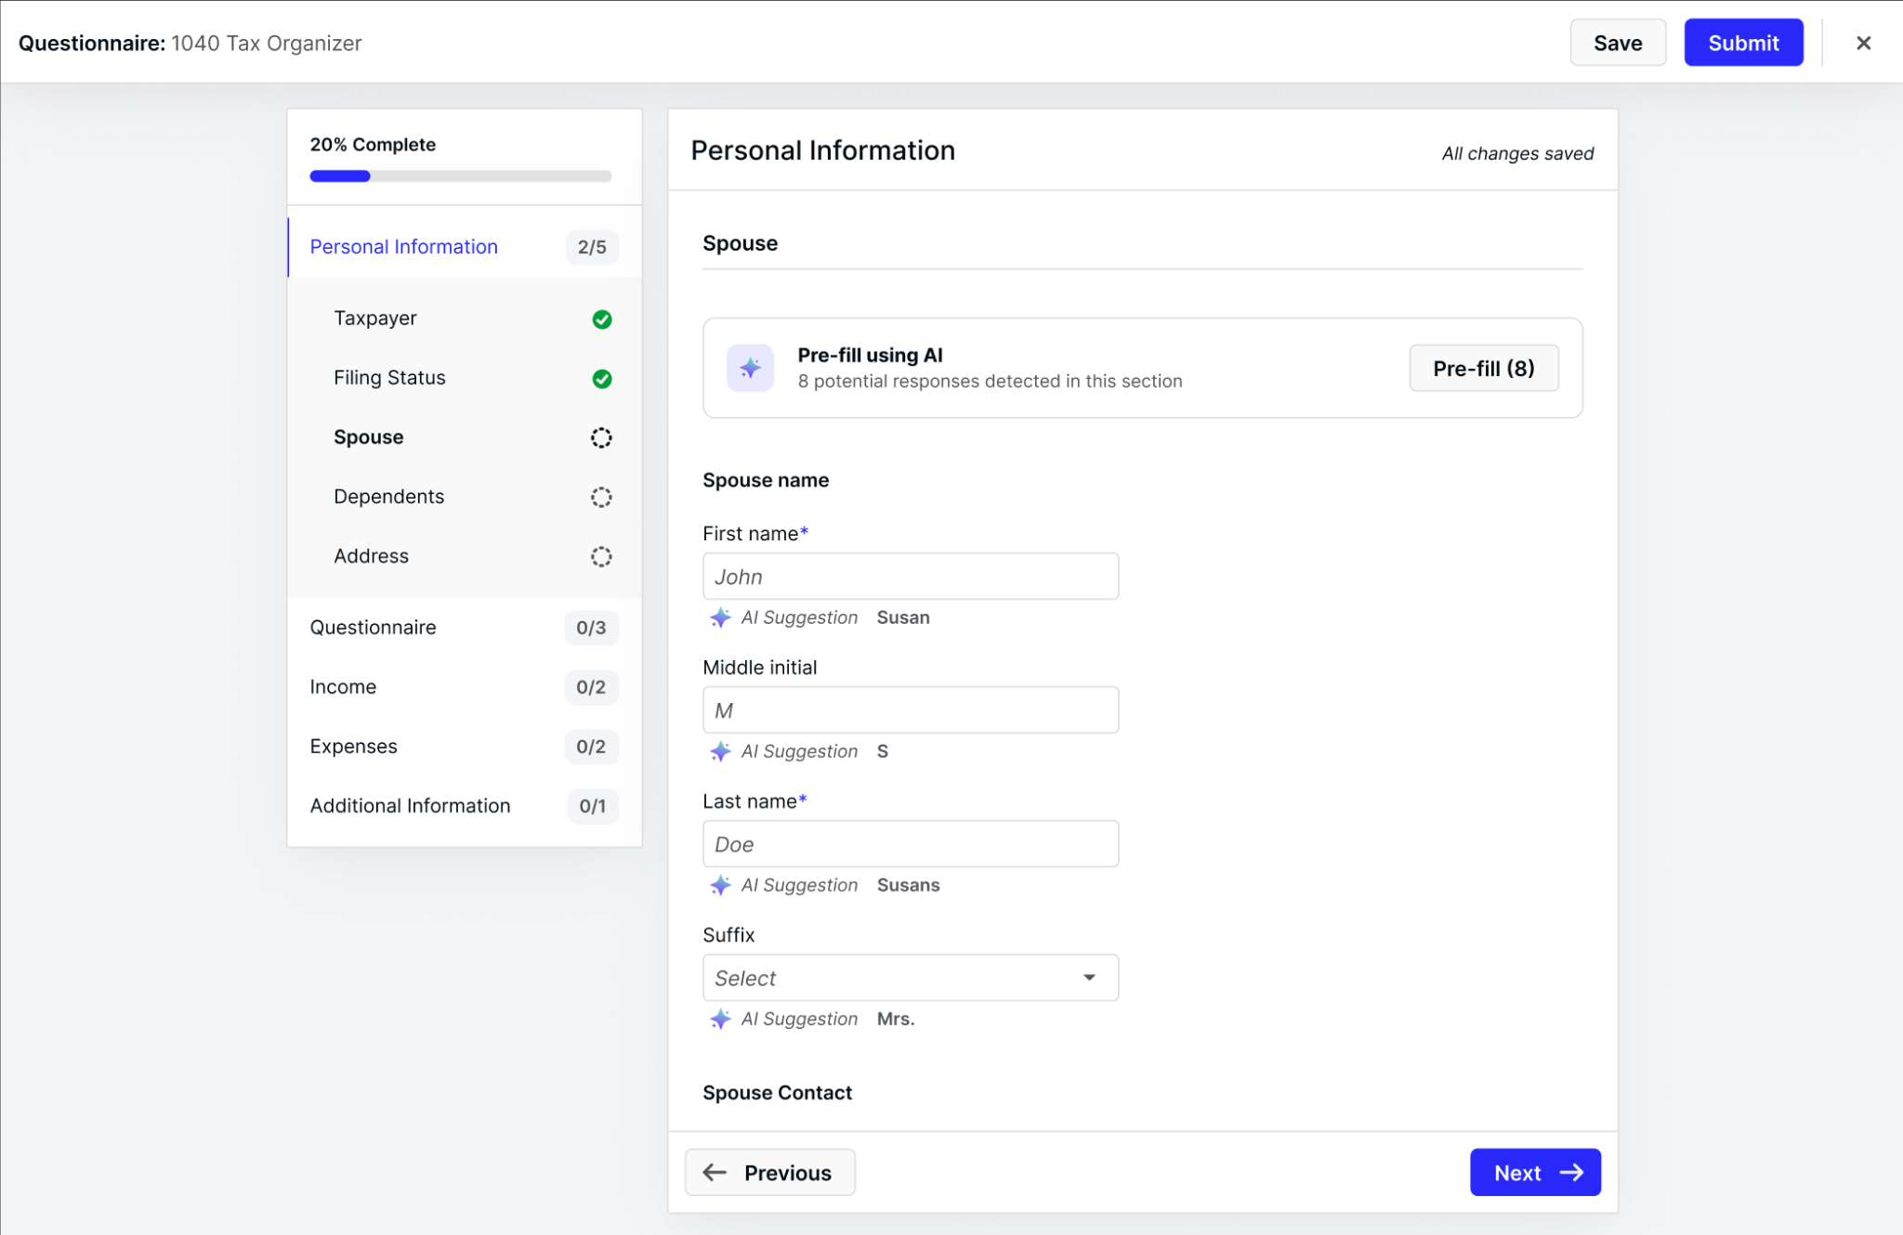
Questionnaires
Decrease data entry for you and your clients. Push data to or from a questionnaire. Powered by past years’ data, communications, and more.
Pre-fill the questionnaire with information you already have. Client can confirm or update.
Notes:
We launched Questionnaires earlier this year as a smarter way to collect client information—streamlined, templated, and easy to complete. And we’re just getting started.
Soon, Questionnaires will be AI-enhanced and tightly integrated with tasks and client requests. With upcoming bidirectional syncing, client responses will auto-fill fields in Canopy—and Canopy data can pre-fill questionnaires.
It’s about reducing manual entry, improving accuracy, and making onboarding faster for everyone.

Slide 22
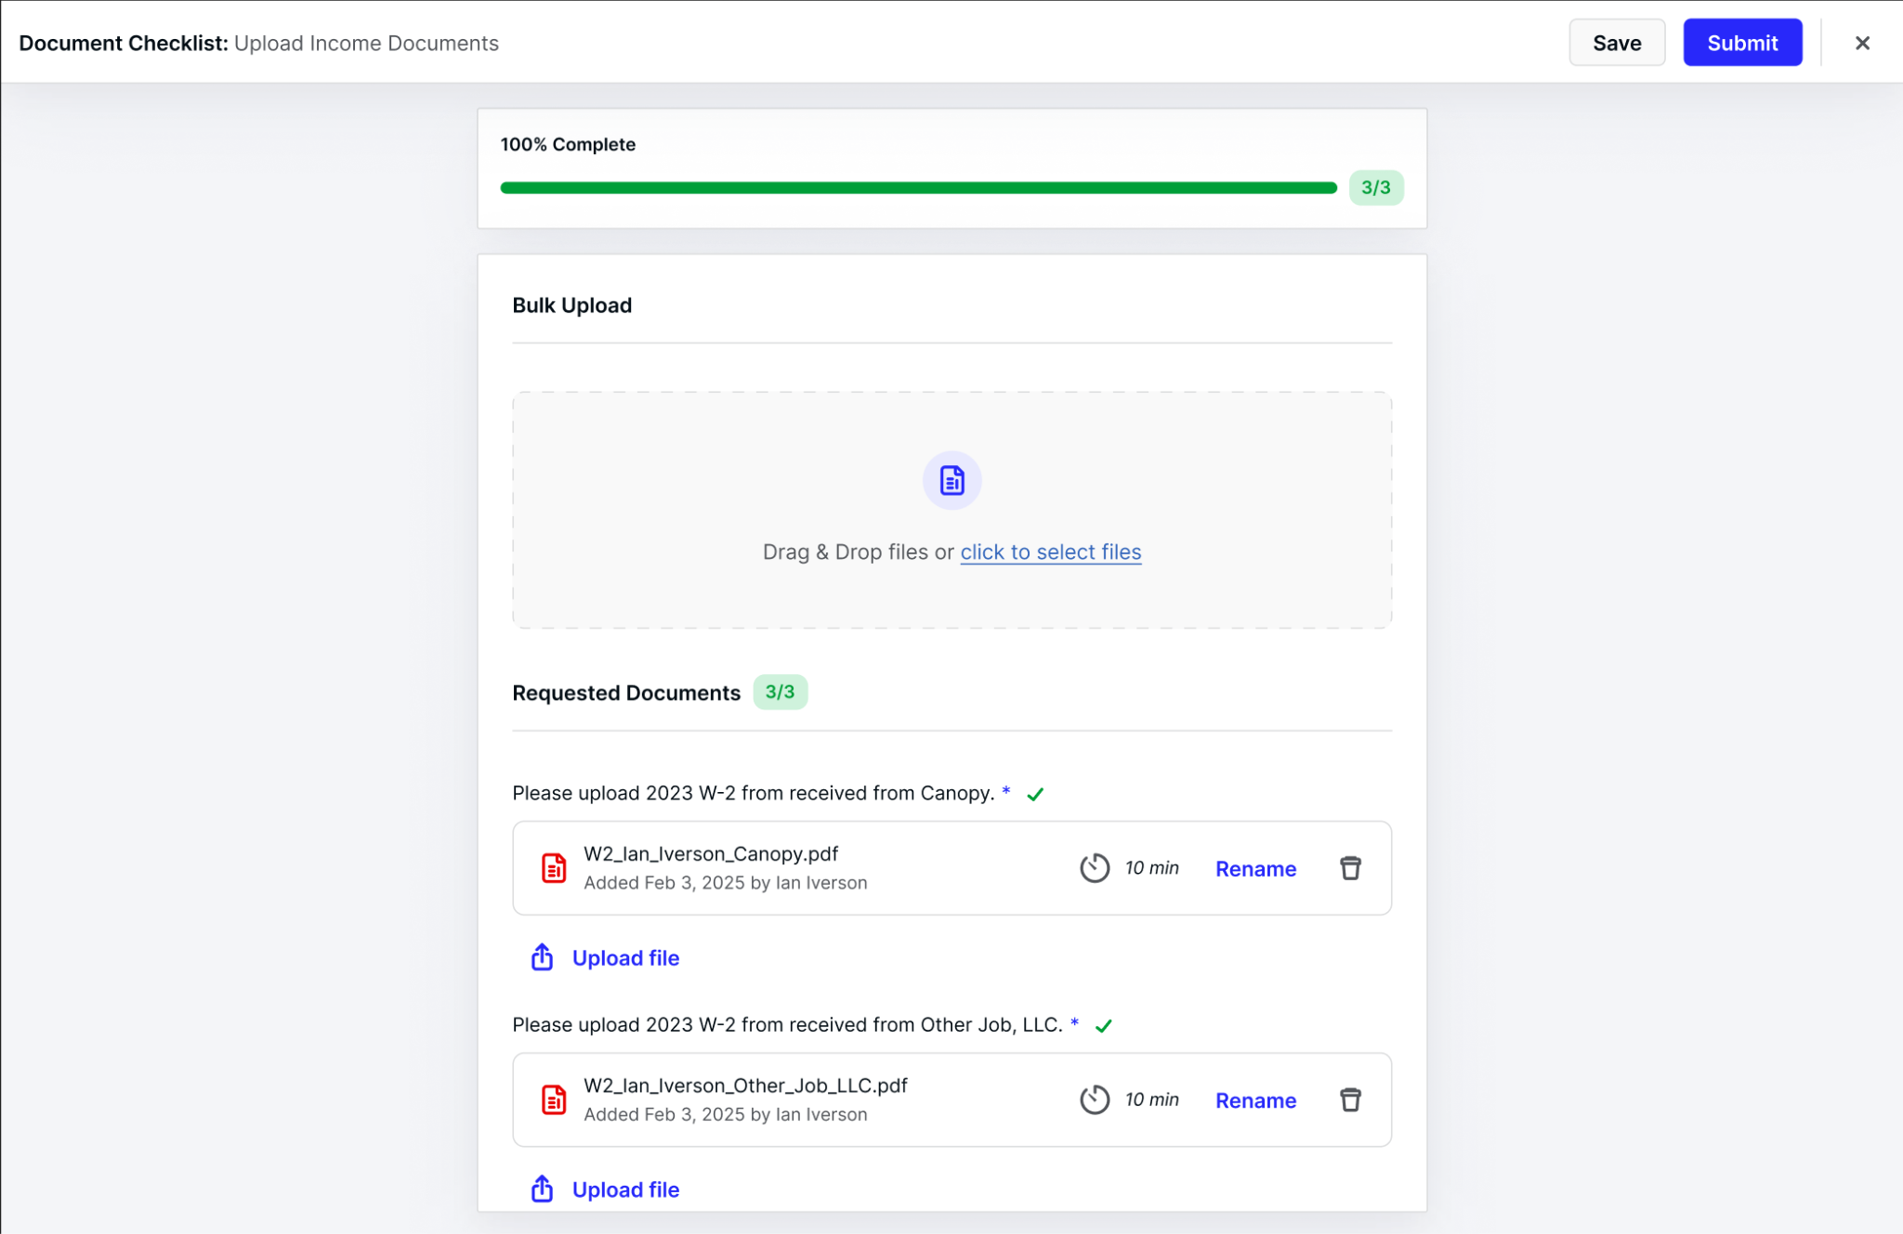
Document Checklists
Send your clients a checklist indicating each item you need. Clients will upload the corresponding file to the matching item on the checklist before marking it as complete.
Notes:
We all know collecting documents can be a frustrating, time-consuming process. Document Checklists change that. You can now request specific documents—like a W-2 or Schedule K—and clients will upload each file directly to the corresponding checklist item.
No more hunting through mystery PDFs or vague email attachments. And with upcoming AI enhancements, Canopy will even help flag incorrect uploads—so you get the right file the first time. It's faster, cleaner, and designed to reduce the back-and-forth.

Slide 23
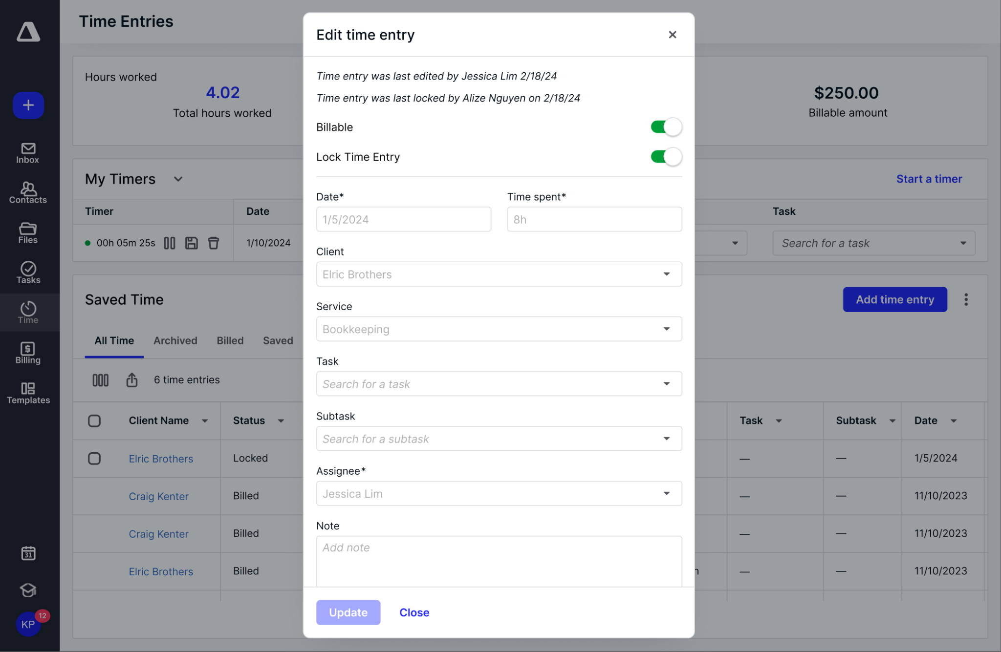
Locked Time Entries
Set up logic for automatic locking. Ensure that time entries don’t change after crucial checkpoints.
Notes:
Time tracking is essential—but it can quickly go sideways when past entries get changed, especially after billing or payroll. With Locked Time Entries, you can prevent that.
You can lock entries manually, in bulk, or set up automation rules so entries lock automatically after a set period or milestone. Think of it like version control for your billable hours—ensuring accuracy, compliance, and peace of mind.

Slide 24
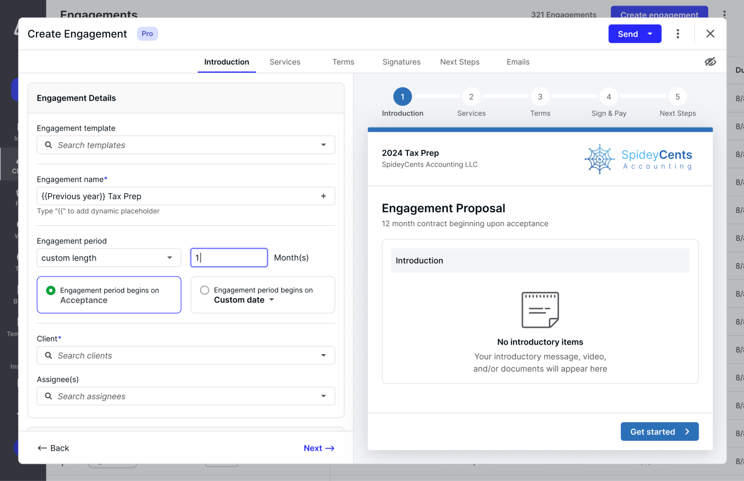
Engagements
Updated engagements builder & client experiences to support more flexible pricing and packaging models alongside a more beautiful and customizable experience for practitioners and clients.
Notes:
You’ve told us you need more flexibility when building and presenting client engagements—and we’ve listened.
We’re revamping the Engagements builder to support customizable pricing, flexible packaging, and a more modern, streamlined experience for both firms and clients. It’s designed to look better, work faster, and fit naturally into your workflow—so you can deliver polished proposals with less effort

Slide 25
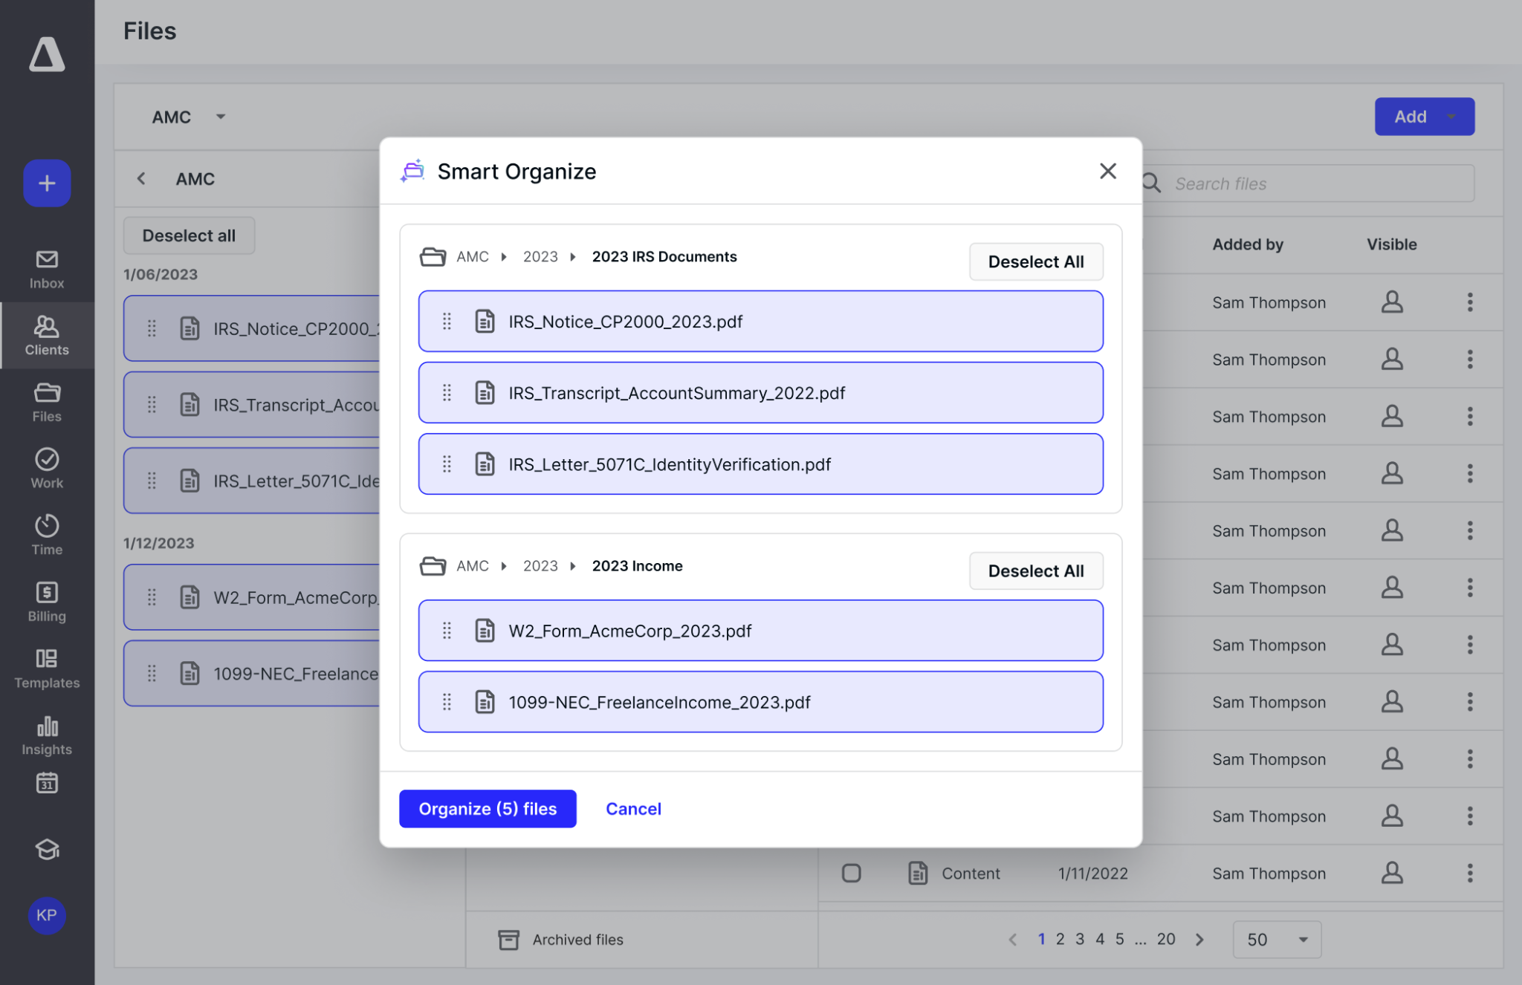
AI Document Organization
Empower users to find what they need faster with deep, intelligent search across all document types.
Use AI to split and organize documents.
Notes:
Documents drive your workflow—but searching through disorganized files slows everything down.
AI Document Organization solves that. With intelligent search and smart filters, you can instantly find what you need—across all document types. You can also split and sort files automatically with just a few clicks.
It’s like having a digital file assistant who’s fast, accurate, and always available.

Slide 26
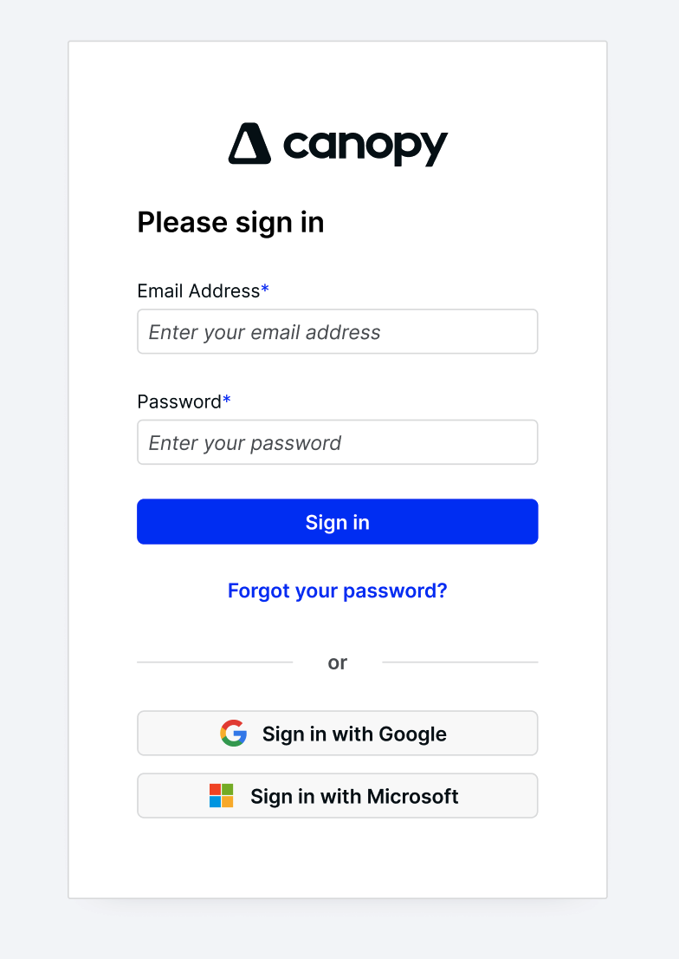
SSO
Reduce password related risks with Google & Microsoft enabled login for staff and clients.
Notes:
“Raise your hand if you’ve reset your password at least 3 times this year. Yep, same. With SSO, your staff and clients can log in using Google or Microsoft accounts. That means fewer forgotten passwords, fewer IT tickets, and one less thing to worry about.”

Slide 27
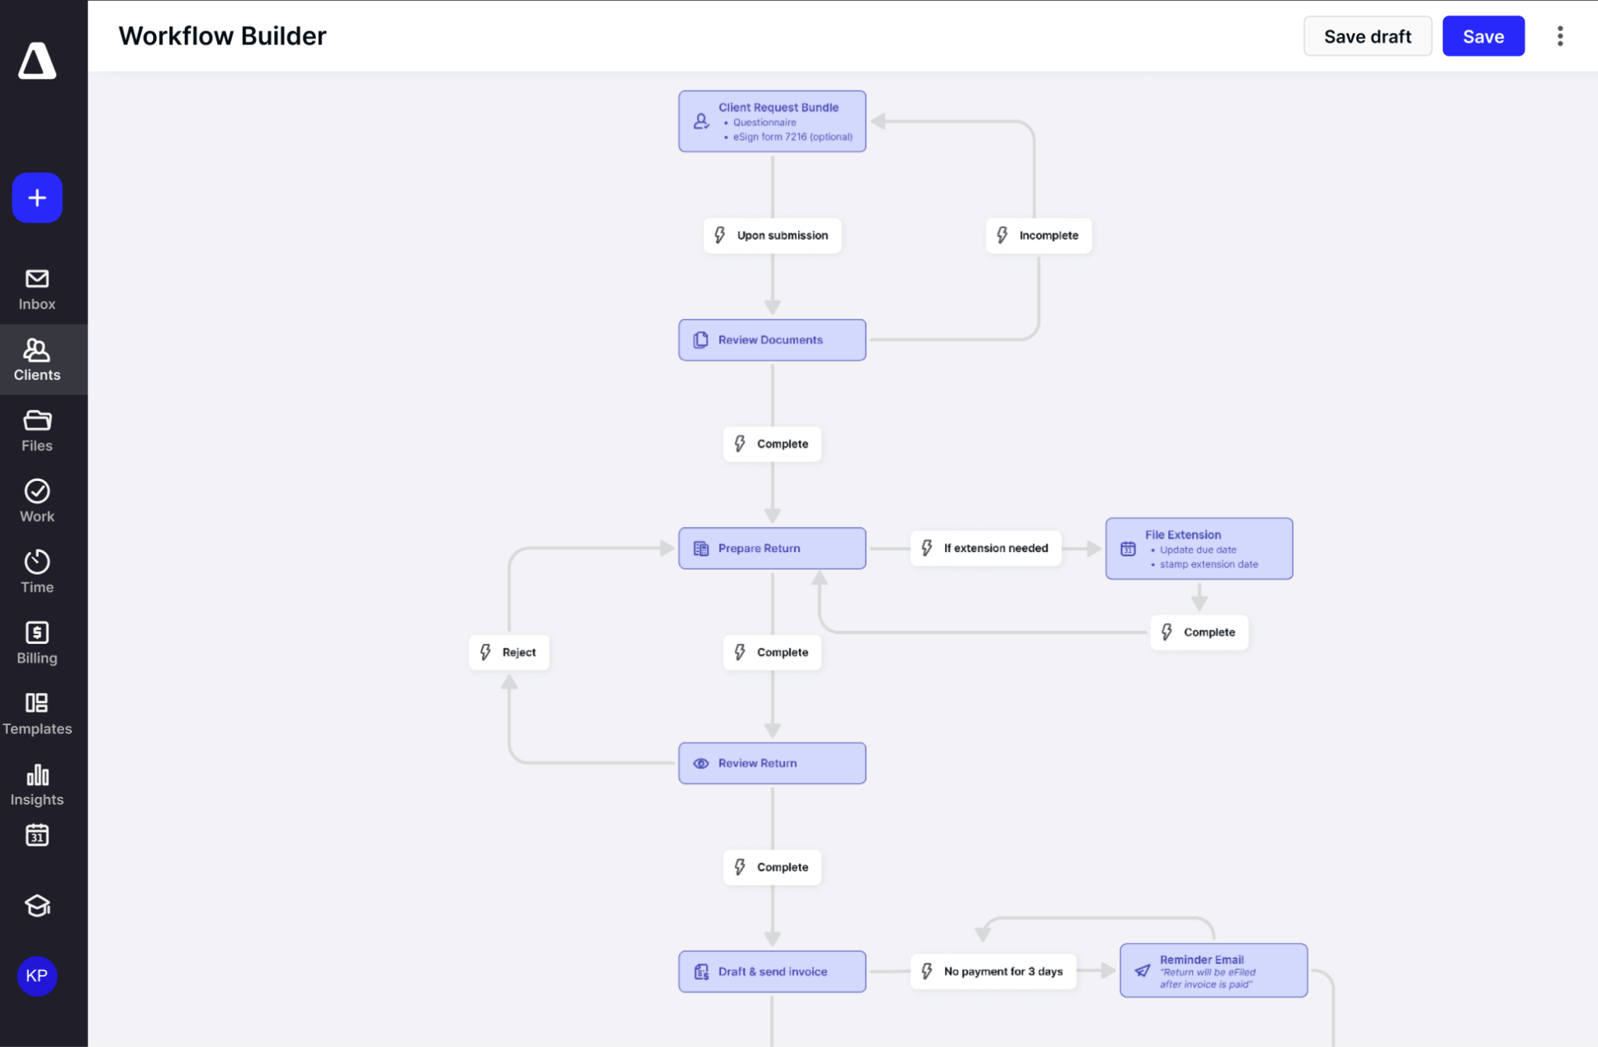
Workflow Automation Builder
A visual event-driven workflow builder that connects modules across Canopy, automating common client workflows and reducing repetitive admin work.
Notes:
“Workflows matter—but building them shouldn’t be a chore.. Our new visual Workflow Automation Builder helps you connect actions across Canopy—automating not just tasks, but full client workflows. Want to trigger an invoice when a task is completed? Done. Want to kick off a new project when a document is uploaded? You got it. It’s powerful, intuitive, and designed to make automation easy—not overwhelming.
That wraps up our roadmap highlights. I’ll hand it back to KC to close us out—thanks again for spending time with us.

Slide 28
Thank You
Notes:
“That’s a wrap! Thanks for spending time with us today—we know how valuable your time is. If you're a customer and want to dive deeper into anything we covered, reach out to Support or your CSM. And if you're a prospect, come see it live—sign up for a demo. We’d love to show you around.”

