Slide 1
Title of Presentation
This is a subhead that helps clarify your confusing headline. Or you can put the name of the presenter here.
BUT KEEP IT CLEAN! See how terrible this much copy looks?!?
Notes:
“Hey friends—Dr. Jackie Meyer here! Show of hands (or thumbs-up emoji in chat): who’s ever thought ‘There’s no way to grow my firm without 60-hour weeks’?— Yeah, I was there too. Today we’re busting that myth. I took my practice from burnt-out slog to a 4-hour work-week and a seven-figure sale, and I’m going to hand you the exact leadership plays I used—no fluff, all field-tested. Buckle up, grab a notepad, and let’s chase profit and peace!”

Slide 2
Title of Presentation
This is a subhead that helps clarify your confusing headline. Or you can put the name of the presenter here.
BUT KEEP IT CLEAN! See how terrible this much copy looks?!?

Slide 3
Meet Dr. Jackie Meyer, CPA
Creator of TaxPlanIQ
Author of The Balanced Millionaire
Built & Sold a 7-figure firm in 2022
4-hour workweek advocate
Notes:
I sound pretty impressive on paper, but have had a rollercoaster journey just like some of you I built and sold a cpa firm Started a tax advisory software for accountants called taxplaniq, 5 yrs in and 8 figure valuation Advocate for you picking the number of weeks you work
Quick rewind: 2010 I launched solo, believing hustle was the secret sauce. By 2016 I was running on fumes and energy drinks, juggling 250 clients for mediocre revenue. Fun fact—I loved working at 3 a.m. because nobody could email me back! Rock-bottom moment: realized I’d built a prison disguised as a firm. Fast-forward: 56 dream clients, 10 self-reliant teammates, 4 owner-hours a week. If I can un-train my workaholic brain, so can you.

Slide 4
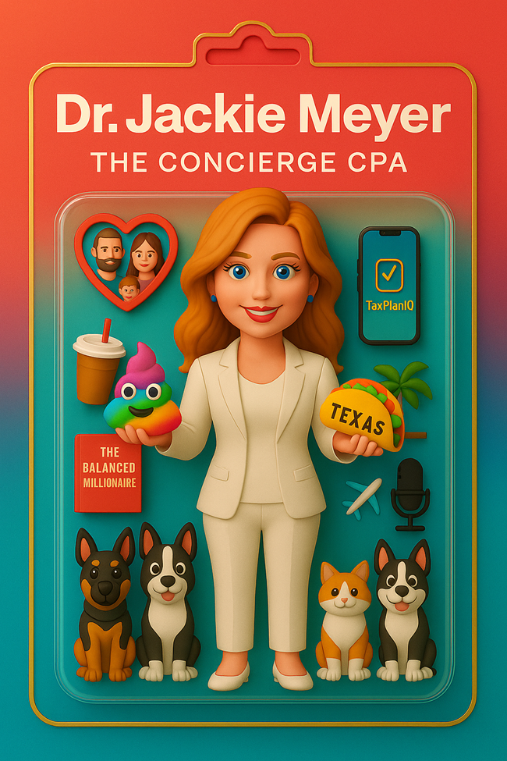

Slide 5
Agenda.
🔥 My Story: Burnout to 7 Figures
💡 You’re Not Lazy (Just Overloaded)
⚠️ 3 Mistakes Keeping You Stuck
🧠 Leadership Models that Actually Work
🔄 The 3 Levers to Scale Your Firm
🎯 Fastest Path to Victory (Playbook)
🧘 The Balance Sheet of Life
✅ 7-Day Challenge + Action Plan
Notes:
Game plan:
1️⃣ My quick burnout horror story (we’ll laugh and learn).
2️⃣ Three leadership mistakes keeping firms small & stressed.
3️⃣ Three levers—Vision, Delegation, Systems—that scale revenue while shrinking hours.
4️⃣ A 7-day challenge so you leave with momentum. Sound good? Let’s roll

Slide 6
My Story of Burnout & Breakthrough
250+ clients, <$350k revenue
Burnout between 2013 - 2016
Catalyst for reinvention

Slide 7
POLL #1

Slide 8
The Shift That Changed Everything
Moved to value-based tax advisory
Narrowed niche, tripled pricing
56 clients, 10 self-reliant team members
7-figure sale, 4-hour weeks

Slide 9
Truth Bomb.
Burnout ≠ weakness
High-achievers have limited bandwidth
Awareness is the first step to freedom

Slide 10
5 Signs of Burnout Leadership
You’re the bottleneck
Team relies on you for everything
You skip family dinners
Feel replaceable but trapped
Think “one more season” will fix it

Slide 11
MISTAKE #1:
Doing everything Yourself
The E-Myth trap
The solo ceiling: 200 clients x $1k = $200k max
Strategy: Delegate, use PMs, set KPIs

Slide 12
Tactical KPIs
That Empower
Track for accountants, PMs, admin
Monthly clarity and trust
Tools: ChatGPT, Canopy, TaxPlanIQ

Slide 13
MISTAKE #2:
No Vision, No Values
Values are your GPS
Examples: honestly, family first
EOS principles: hire/fire/promote by values

Slide 14
POLL #2

Slide 15
Vision-Crafting Workshop
Write your 3-year vision
Consider: Revenue, hours, team, services, lifestyle
Share with a peer or group

Slide 16
MISTAKE #3:
Ignoring Leadership Gaps
CPAs ≠ born leaders
Admin limits → Elevate others
Promote, delegate, elevate

Slide 17
Maxwell’s 5 Levels of Leadership
Position
Permission
Production
People development
Pinnacle

Slide 18
Self-Assessment: Leadership level
Reflect: Team, clients, peers
What level are you now?
What level do you aspire to?

Slide 19
5 Game-Changing Questions

Slide 20
QUESTION 1:
What Does Success Look like?
Define your vision
Freedom > Profit
Visualize 3-5 year lifestyle

Slide 21
QUESTION 2:
Who Are Your Best Clients?
Audit: Clone vs. cringe clients
Niche down, increase fees
Fire 60%, triple revenue

Slide 22
QUESTION 3:
Are You the Bottleneck?
Delegation mindset
80% Rule
Be the architect, not the hero

Slide 23
QUESTION 4:
Who Runs the Firm Off-Grid?
Org chart vs. ego
COO, PMs
Ownership > dependency

Slide 24
QUESTION 5:
Are Your Systems Scalable?
Duct tape → streamlined
SOPS, AI tools
Smart tech stack

Slide 25
POLL #3

Slide 26
The Balance Sheet of Life
10 life assets: Align life + business success
Passion - what lights you up
Purpose - Why you exist
Profit - Your finances and cash flow
People - Relationships that matter
Peace - Mindfulness, spirituality, rest
Place - Your environment and surroundings
Play - Fun, hobbies, and enjoyment
Physical Health - Mind & body wellness
Progress - Learning and personal growth
Philanthropy - Giving back and impact

Slide 27
Case Study: Scaling with Peace
Before/After leadership
More revenue, fewer hours
Happier team, better service

Slide 28
Recap 7-Figure, 4-Hour Firm
Define success
Focus your niche
Delegate + track
Empower leaders
Build systems

Slide 29
Take Action: 7-Day Challenge
Assign 1 measureable
Draft vision
Audit + automate
Assess leadership level
Bless-and-release 1 client

Slide 30
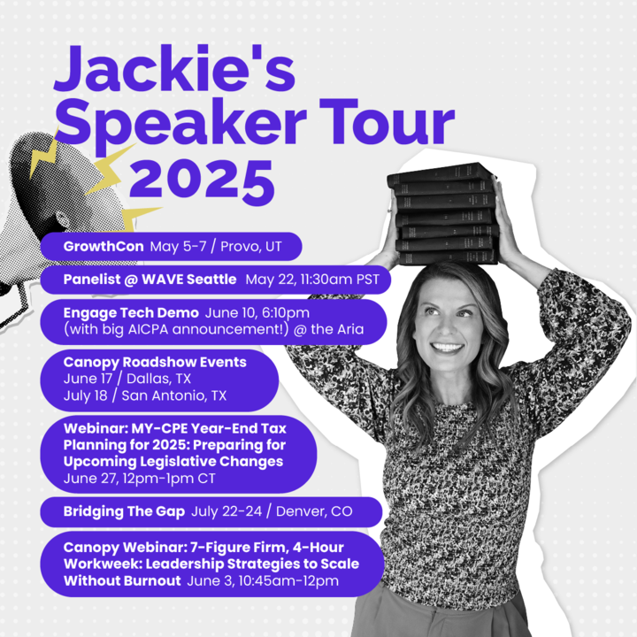
Join
The Book Waitlist (And Sneak Peek)
Notes:
https://kickofflabs.com/giveaway/balanced-millionaire-signup

Slide 31
Q & A
Notes:
What if I’m solo? Can I still delegate?” Start with a part-time VA (10 hrs/week), outsource bookkeeping cleanup, or engage a seasonal tax preparer. Delegation isn’t about staff size—it’s about offloading low-value tasks.
“Clients push back on higher fees—how respond?” Lead with ROI: “This plan saves you $34k—our fixed fee is $8k. Your net gain: $26k.” If they balk, they’re not your ideal client.
“I worry staff will make mistakes.” Mistakes happen; the cost of never letting go is higher. Pair checklist + review → error rate plummets. Coach, don’t confiscate.
“Which KPI should every small firm track first?” Effective hourly rate = Total collected ÷ Owner hours. Watch that climb as you delegate and niche.

Slide 32
“Your firm can grow. Your life can feel lighter. You just need the right mindset and team.”
– Dr. Jackie Meyer, CPA
Notes:
One last repeat of our mantra:
• Vision sets the target.
• Delegation frees the leader.
• Systems keep the wheels turning.
Nail those three levers and you’ll trade burnout for balanced growth. Now go build that 7-figure, 4-hour reality!

