Slide 1
The 5 Major Money Leaks:
How to Plug the Profit Drain and Maximize the Revenue Potential in Your Firm

Slide 2
Do You Feel Like…
You feel overworked and underpaid, and no matter how many hours you work you STILL can’t get ahead?
You struggle to make and keep boundaries with clients, or feel like you can’t ever say no?
You’re always answering “quick” questions, doing work for free, or doing favors for clients “just this one time” hoping to make up for it later?
You don’t know how to clearly communicate what you do for your clients, and they’re not always sure what they’re getting for their money?
You know you need a better system to enroll and communicate with clients about the work you do, but aren’t sure what that looks like?
Notes:
Example: Value of the outcome
Example a tax plan. The outcome is the total savings you are reduced what they are paying to the IRS.
What’s it worth? anxiety, stress and no clarity. That is priceless
Client 1:
I had the confidence to charge a client $4000 for clean-up work when I would have maybe charged her $1000 before (if at all) and I've upgraded two business clients to higher packages that net me about $1600 more per month.
Client 2:
Michelle’s course helped me to identify what was going wrong in my business and showed me how to make corrections to move forward. I’ve already gained a new client at $3k per month. They were only paying $250 per month before, which is an 1100% increase.
Client 3:
However, enrolling in the course and applying the principles taught has made a drastic difference. I experienced immediate success and increased collected revenue of over $93K during a 5 month period and monthly recurring revenue up over $8K.
Client 4:
During the course, one of my clients was scared and feared the IRS placing liens on his assets. I charged this client $7,995 for tax resolution work, previously I would have charged only $350 for the tax return. After investing in the course and with some skepticism, I didn't know where the course would take me. In just a couple of weeks I could see the long-term gains/benefits as it relates to an improved mental attitude and mindset.
Client 5:
For instance, in the first two weeks I made $2,000 more than I previously would have charged on a service I regularly provide, and have been consistent since. These wins allowed me to quit my corporate job six months sooner than anticipated and focus on my firm 100%. (This client went from averaging $3k per month to now $30k per month)
Client 6:
Just wanted to give you an update on my journey since I started working with you in July 2021. Comparing the last 6 months of 2020 to the last six months of 2021, my collected revenue is $80K more in 2021 for the same period of time. Expecting to collect another $10K by the end of the year – which would be a $90K increase. I should close the year at $480K in revenue compared to $340K in 2020. Your coaching program has been the best investment and completely shifted my mindset.
Client 7:
Before I met Michelle, I had $27,545 in receivables. I was sending past due notices but was really struggling collecting the funds we were owed. In just the first week of the Sales Mastery course and the live training I changed my focus on A/R. I completed these services and I deserved to be paid. I began calling clients, emailing them payment links, and texting them every 3 days. Within the second week of class, I collected $10,895 of my outstanding A/R! and now, 4 months after I started the program, I have collected 100% of my A/R.
Client 8:
What we learned in the 8 Week Sales Mastery Training was building confidence in the value of what we provide to our clients, getting rid of doing any free work, and stopped the inherent liability of advising people before you are engaged. We now sleep better, do better work for clients, and we increased firm revenue by $100k in just 2 months by charging for services we never had before and got rid of ⅓ of the people.
Client 9:
I wanted to let you know that I was finishing up my August accounting for DLMM and decided to take a look at the Sales by Client, comparing 3/1/21-8/31/21 to 3/1/20-8/31/20, and overall including new & lost clients, my billed revenue has increased by 41.25% or $38,800 over this six month period. (My new rate structure was effective 3/1/2021) Between increasing fees with my established clients as well as how I determine fees for new clients, it is a material change in gross revenues.
Client 10:
2019 $288,657
2020 $310,221 After unprofitable client purge
2021 $409,624
2022 Projection $600K
Please let me know if you need any more! I have plenty more!

Slide 3
If you said YES to any one of these,
you have a money leak in your firm that needs to be fixed ASAP!
Shift summary/one-liner
This process is the backbone of a successful firm.

Slide 4
Why Would You Listen to Me?
Hundreds of my accounting, bookkeeping and tax firm clients have doubled their firm revenue and gained time freedom by a process that I spent 20+ years perfecting.
Our clients have collectively increased their revenue over $20 Million from their base revenues.
When it comes to accountants and tax pros, to get these transformational results, we are the best at what we do.

Slide 5
Money Leak #1:
Taking on Clients that Aren’t a Fit for You
Shift summary/one-liner
This process is the backbone of a successful firm.

Slide 6
Have You Ever…
Taken on a client that wasn’t a fit for you?
Charged less than you’re worth or given a discount?
Taken on a client because you’re stressed about money?
Continued working with a client that drives you crazy?
Have long-term clients that have never had their rates raised?

Slide 7
You DO NOT have to work with whoever is in front of you…and you shouldn’t want to either!
The temptation to accept every client that comes your way is NOT worth your time, energy, & missed opportunities. Success comes from an abundance mindset, setting boundaries, and having a clear vision for your firm.

Slide 8
We want to speak to a specific client with specific goals AND with specific dreams.
The more you know about what your clients want and why they want it, the more your message will reach those types of clients and the easier it will be to communicate your value to them - and charge them premium fees for your services.

Slide 9
Know Who Qualifies to Work with You
Would an oral surgeon take on a client that just needed a teeth cleaning?
Would a brain surgeon see a patient that just had a head cold?
Would a personal injury lawyer take on someone trying to get out of a parking ticket?
Should YOU take on clients that don’t match your expertise or vision for your firm?

Slide 10
Know Your Ideal Client
Knowing exactly who your ideal client is will allow you to take your power back and get the right clients who pay you what you’re worth.
My ideal client is ready to take action now.
I only work with clients who have more than $200k in annual income.
I only work with clients who want ongoing services.
I don’t work with anyone who is just price shopping.
I only work with clients in X industry.

Slide 11
Create a Different Experience
Your ideal client wants and needs a completely different experience. If your ideal client is a $1M business, you can’t be a typical accountant.
Technical expertise and “good service” is not enough!
If you're just winging it or doing what everyone else is doing, you’re going to get what everyone else is getting.
Have an abundance mindset and be willing to say NO to someone that is not a fit for you.

Slide 12
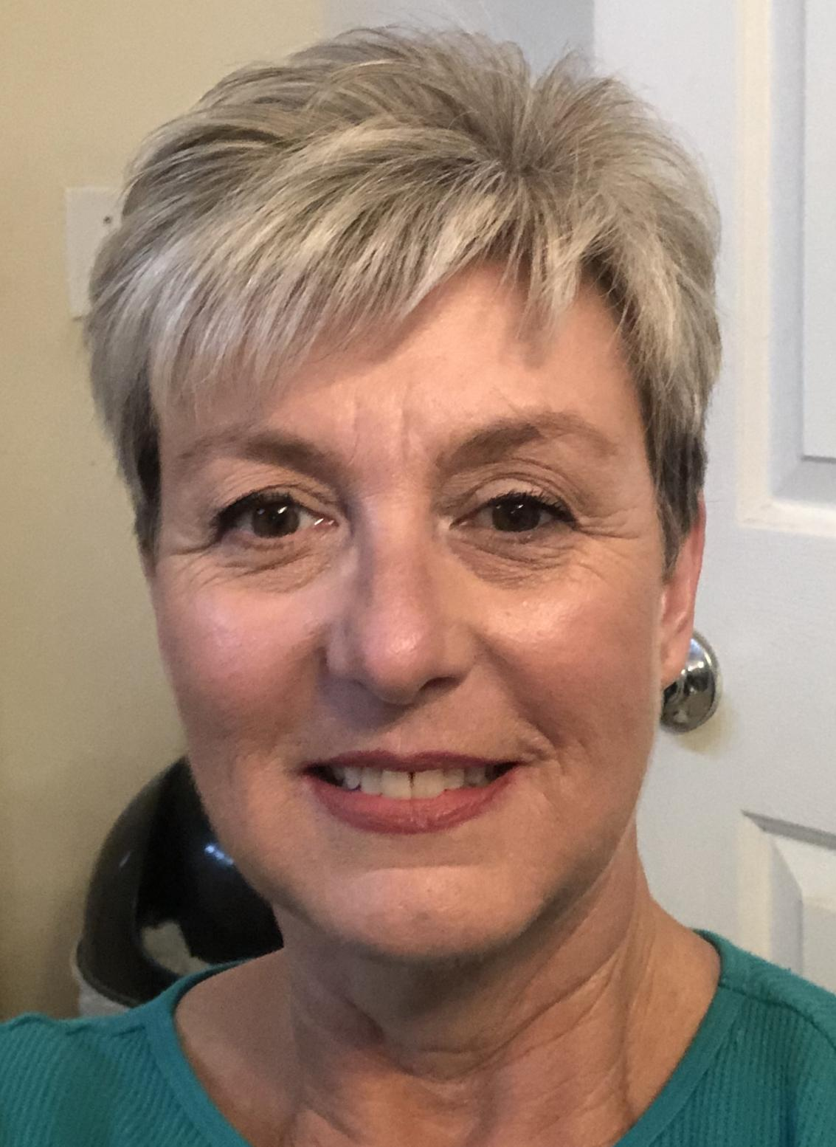
Meet Janice…
Was feeling depressed, stuck in a rut and didn’t know how to implement a system in the firm she bought 3 years ago.
We helped her to immediately identify her ideal client and she started increasing ALL of her fees (she only had one complaint & that client ended up staying with her!)
She let go of several clients that were not making her happy after realizing that she was doing a disservice to those clients by retaining them, and this greatly reduced her stress
She collected over $3,600 in A/R and added an additional $7,500 in revenue in 8 weeks

Slide 13
Knowing Your Ideal Client and Saying NO to Everyone Else Allows to to Charge Higher Fees and Work SMARTER, not HARDER
Shift summary/one-liner
This process is the backbone of a successful firm.

Slide 14
Money Leak #2:
Giving Away Free Advice & Answering “Quick” Questions
Shift summary/one-liner
This process is the backbone of a successful firm.

Slide 15
YOU MUST STOP GIVING YOUR
KNOWLEDGE AWAY FOR FREE!

Slide 16
Giving your time and expertise away for free will NEVER get you the results you want.
You will end up feeling used, undervalued, and working with people who are not a fit for you. How often does a “quick question” or doing something “additional” come up where it takes you a ton of extra time, that you’re not being paid for?

Slide 17
How to Protect Your Inventory
STOP Giving Out Band-Aids
PREPARE
Ahead of Time
Stick to Your Boundaries & Ideal Clients
Ask the Right Questions

Slide 18
Asking the RIGHT Questions
There’s ALWAYS a “why” behind the “why.”
The more layers you can peel back to understand the pain, the closer you can get to your client’s REAL why and the real challenges that they are facing.

Slide 19
Example: “How Much Do You Charge?”
What made you reach out to me today to explore a new CPA firm?
Before we begin exploring what you are looking for, I’m just curious what made you reach out to me today?

Slide 20
If you visit the doctor, how does the doctor know what’s really going on?
The doctor asks specific questions to get the information they need to make a diagnosis. Just like a doctor does, you have to strategically poke around to discover the true pain. It’s time to do a financial diagnosis!
Notes:
Introduce the Doctor Frame

Slide 21
When you ask the right questions that get to the REAL pain and give a prospect an accurate diagnosis, they will assume you have the best and only solution.
Just be genuinely curious and ask strategic questions to get to the root of the problem. They need YOU, not the other way around!

Slide 22
When you PROTECT YOUR INVENTORY, you can go from chasing new clients and money to providing lifetime value!
Shift summary/one-liner
This process is the backbone of a successful firm.

Slide 23
Shift summary/one-liner
Money Leak #3:
Scope Creep
This process is the backbone of a successful firm.

Slide 24
Sound Familiar…?
Do you tend to cringe when clients ask you to do more work than they’ve originally hired you to do?
Or when they take up your time, picking your brain on how to manage their accounting or bookkeeping better?
Are you frustrated by the seemingly endless number of ‘just one last thing’ emails?
Do you feel like you’re always working more but not making more?
Notes:
Introduce the Doctor Frame

Slide 25
Then you have SCOPE CREEP!
Scope Creep occurs in two ways:
Clients explicitly ask you to do something you didn’t agree to (work that isn’t in the original plan, the client changes the plan mid-project)
1
You provide extra services for a client that are needed that clients are not paying for (you discover the project requires a deeper level of work than originally thought or new services are needed when a client’s situation changes)
2

Slide 26
Scope Creep is a GOOD THING when managed properly!
It’s a new opportunity for both you AND your clients.
This could be a sign that their business is growing or their finances are improving. This is something to be celebrated with them!
A new ask from a client is just another opportunity for you to position yourself as the expert that has the solution to their problem and provide additional services (for a fee, of course!) Think UPSELLS!
Notes:
Example: Value of the outcome
Example a tax plan. The outcome is the total savings you are reduced what they are paying to the IRS.
What’s it worth? anxiety, stress and no clarity. That is priceless
Client 1:
I had the confidence to charge a client $4000 for clean-up work when I would have maybe charged her $1000 before (if at all) and I've upgraded two business clients to higher packages that net me about $1600 more per month.
Client 2:
Michelle’s course helped me to identify what was going wrong in my business and showed me how to make corrections to move forward. I’ve already gained a new client at $3k per month. They were only paying $250 per month before, which is an 1100% increase.
Client 3:
However, enrolling in the course and applying the principles taught has made a drastic difference. I experienced immediate success and increased collected revenue of over $93K during a 5 month period and monthly recurring revenue up over $8K.
Client 4:
During the course, one of my clients was scared and feared the IRS placing liens on his assets. I charged this client $7,995 for tax resolution work, previously I would have charged only $350 for the tax return. After investing in the course and with some skepticism, I didn't know where the course would take me. In just a couple of weeks I could see the long-term gains/benefits as it relates to an improved mental attitude and mindset.
Client 5:
For instance, in the first two weeks I made $2,000 more than I previously would have charged on a service I regularly provide, and have been consistent since. These wins allowed me to quit my corporate job six months sooner than anticipated and focus on my firm 100%. (This client went from averaging $3k per month to now $30k per month)
Client 6:
Just wanted to give you an update on my journey since I started working with you in July 2021. Comparing the last 6 months of 2020 to the last six months of 2021, my collected revenue is $80K more in 2021 for the same period of time. Expecting to collect another $10K by the end of the year – which would be a $90K increase. I should close the year at $480K in revenue compared to $340K in 2020. Your coaching program has been the best investment and completely shifted my mindset.
Client 7:
Before I met Michelle, I had $27,545 in receivables. I was sending past due notices but was really struggling collecting the funds we were owed. In just the first week of the Sales Mastery course and the live training I changed my focus on A/R. I completed these services and I deserved to be paid. I began calling clients, emailing them payment links, and texting them every 3 days. Within the second week of class, I collected $10,895 of my outstanding A/R! and now, 4 months after I started the program, I have collected 100% of my A/R.
Client 8:
What we learned in the 8 Week Sales Mastery Training was building confidence in the value of what we provide to our clients, getting rid of doing any free work, and stopped the inherent liability of advising people before you are engaged. We now sleep better, do better work for clients, and we increased firm revenue by $100k in just 2 months by charging for services we never had before and got rid of ⅓ of the people.
Client 9:
I wanted to let you know that I was finishing up my August accounting for DLMM and decided to take a look at the Sales by Client, comparing 3/1/21-8/31/21 to 3/1/20-8/31/20, and overall including new & lost clients, my billed revenue has increased by 41.25% or $38,800 over this six month period. (My new rate structure was effective 3/1/2021) Between increasing fees with my established clients as well as how I determine fees for new clients, it is a material change in gross revenues.
Client 10:
2019 $288,657
2020 $310,221 After unprofitable client purge
2021 $409,624
2022 Projection $600K
Please let me know if you need any more! I have plenty more!

Slide 27
Managing Scope Creep
Stop assuming that a client doesn’t or wouldn’t expect to pay for additional services they’re asking for!
Here is the hard truth: In most cases, you’re simply not holding a boundary in order to people please or avoid an uncomfortable conversation.
Remember that YOU are the expert and YOU are in control of your time and energy. They are coming to you for help and you deserve to be paid accordingly.
Connection and Communication is KEY.
Notes:
Example: Value of the outcome
Example a tax plan. The outcome is the total savings you are reduced what they are paying to the IRS.
What’s it worth? anxiety, stress and no clarity. That is priceless
Client 1:
I had the confidence to charge a client $4000 for clean-up work when I would have maybe charged her $1000 before (if at all) and I've upgraded two business clients to higher packages that net me about $1600 more per month.
Client 2:
Michelle’s course helped me to identify what was going wrong in my business and showed me how to make corrections to move forward. I’ve already gained a new client at $3k per month. They were only paying $250 per month before, which is an 1100% increase.
Client 3:
However, enrolling in the course and applying the principles taught has made a drastic difference. I experienced immediate success and increased collected revenue of over $93K during a 5 month period and monthly recurring revenue up over $8K.
Client 4:
During the course, one of my clients was scared and feared the IRS placing liens on his assets. I charged this client $7,995 for tax resolution work, previously I would have charged only $350 for the tax return. After investing in the course and with some skepticism, I didn't know where the course would take me. In just a couple of weeks I could see the long-term gains/benefits as it relates to an improved mental attitude and mindset.
Client 5:
For instance, in the first two weeks I made $2,000 more than I previously would have charged on a service I regularly provide, and have been consistent since. These wins allowed me to quit my corporate job six months sooner than anticipated and focus on my firm 100%. (This client went from averaging $3k per month to now $30k per month)
Client 6:
Just wanted to give you an update on my journey since I started working with you in July 2021. Comparing the last 6 months of 2020 to the last six months of 2021, my collected revenue is $80K more in 2021 for the same period of time. Expecting to collect another $10K by the end of the year – which would be a $90K increase. I should close the year at $480K in revenue compared to $340K in 2020. Your coaching program has been the best investment and completely shifted my mindset.
Client 7:
Before I met Michelle, I had $27,545 in receivables. I was sending past due notices but was really struggling collecting the funds we were owed. In just the first week of the Sales Mastery course and the live training I changed my focus on A/R. I completed these services and I deserved to be paid. I began calling clients, emailing them payment links, and texting them every 3 days. Within the second week of class, I collected $10,895 of my outstanding A/R! and now, 4 months after I started the program, I have collected 100% of my A/R.
Client 8:
What we learned in the 8 Week Sales Mastery Training was building confidence in the value of what we provide to our clients, getting rid of doing any free work, and stopped the inherent liability of advising people before you are engaged. We now sleep better, do better work for clients, and we increased firm revenue by $100k in just 2 months by charging for services we never had before and got rid of ⅓ of the people.
Client 9:
I wanted to let you know that I was finishing up my August accounting for DLMM and decided to take a look at the Sales by Client, comparing 3/1/21-8/31/21 to 3/1/20-8/31/20, and overall including new & lost clients, my billed revenue has increased by 41.25% or $38,800 over this six month period. (My new rate structure was effective 3/1/2021) Between increasing fees with my established clients as well as how I determine fees for new clients, it is a material change in gross revenues.
Client 10:
2019 $288,657
2020 $310,221 After unprofitable client purge
2021 $409,624
2022 Projection $600K
Please let me know if you need any more! I have plenty more!

Slide 28
Connect & Communicate
The way you say things matters to your client. It’s not just about numbers.
People need and want to be heard. It’s about listening and acknowledging their goals, their fears, and their questions.
Reiterate back to them what they said to make sure you heard them right.
Allow the client to answer questions based on their current situation. Keep going deeper until they guide themselves to see they don’t have a solution without your help.
The more gathering of information you do upfront, the less scope creep you’ll experience later.
Notes:
Example: Value of the outcome
Example a tax plan. The outcome is the total savings you are reduced what they are paying to the IRS.
What’s it worth? anxiety, stress and no clarity. That is priceless
Client 1:
I had the confidence to charge a client $4000 for clean-up work when I would have maybe charged her $1000 before (if at all) and I've upgraded two business clients to higher packages that net me about $1600 more per month.
Client 2:
Michelle’s course helped me to identify what was going wrong in my business and showed me how to make corrections to move forward. I’ve already gained a new client at $3k per month. They were only paying $250 per month before, which is an 1100% increase.
Client 3:
However, enrolling in the course and applying the principles taught has made a drastic difference. I experienced immediate success and increased collected revenue of over $93K during a 5 month period and monthly recurring revenue up over $8K.
Client 4:
During the course, one of my clients was scared and feared the IRS placing liens on his assets. I charged this client $7,995 for tax resolution work, previously I would have charged only $350 for the tax return. After investing in the course and with some skepticism, I didn't know where the course would take me. In just a couple of weeks I could see the long-term gains/benefits as it relates to an improved mental attitude and mindset.
Client 5:
For instance, in the first two weeks I made $2,000 more than I previously would have charged on a service I regularly provide, and have been consistent since. These wins allowed me to quit my corporate job six months sooner than anticipated and focus on my firm 100%. (This client went from averaging $3k per month to now $30k per month)
Client 6:
Just wanted to give you an update on my journey since I started working with you in July 2021. Comparing the last 6 months of 2020 to the last six months of 2021, my collected revenue is $80K more in 2021 for the same period of time. Expecting to collect another $10K by the end of the year – which would be a $90K increase. I should close the year at $480K in revenue compared to $340K in 2020. Your coaching program has been the best investment and completely shifted my mindset.
Client 7:
Before I met Michelle, I had $27,545 in receivables. I was sending past due notices but was really struggling collecting the funds we were owed. In just the first week of the Sales Mastery course and the live training I changed my focus on A/R. I completed these services and I deserved to be paid. I began calling clients, emailing them payment links, and texting them every 3 days. Within the second week of class, I collected $10,895 of my outstanding A/R! and now, 4 months after I started the program, I have collected 100% of my A/R.
Client 8:
What we learned in the 8 Week Sales Mastery Training was building confidence in the value of what we provide to our clients, getting rid of doing any free work, and stopped the inherent liability of advising people before you are engaged. We now sleep better, do better work for clients, and we increased firm revenue by $100k in just 2 months by charging for services we never had before and got rid of ⅓ of the people.
Client 9:
I wanted to let you know that I was finishing up my August accounting for DLMM and decided to take a look at the Sales by Client, comparing 3/1/21-8/31/21 to 3/1/20-8/31/20, and overall including new & lost clients, my billed revenue has increased by 41.25% or $38,800 over this six month period. (My new rate structure was effective 3/1/2021) Between increasing fees with my established clients as well as how I determine fees for new clients, it is a material change in gross revenues.
Client 10:
2019 $288,657
2020 $310,221 After unprofitable client purge
2021 $409,624
2022 Projection $600K
Please let me know if you need any more! I have plenty more!

Slide 29
Example:
“Isn’t this already included in the price?”
“What I’m hearing is that you’re wondering why this isn’t included in the price you’re already paying. I understand how you feel and other clients have felt the same way…”
Notes:
Example: Value of the outcome
Example a tax plan. The outcome is the total savings you are reduced what they are paying to the IRS.
What’s it worth? anxiety, stress and no clarity. That is priceless
Client 1:
I had the confidence to charge a client $4000 for clean-up work when I would have maybe charged her $1000 before (if at all) and I've upgraded two business clients to higher packages that net me about $1600 more per month.
Client 2:
Michelle’s course helped me to identify what was going wrong in my business and showed me how to make corrections to move forward. I’ve already gained a new client at $3k per month. They were only paying $250 per month before, which is an 1100% increase.
Client 3:
However, enrolling in the course and applying the principles taught has made a drastic difference. I experienced immediate success and increased collected revenue of over $93K during a 5 month period and monthly recurring revenue up over $8K.
Client 4:
During the course, one of my clients was scared and feared the IRS placing liens on his assets. I charged this client $7,995 for tax resolution work, previously I would have charged only $350 for the tax return. After investing in the course and with some skepticism, I didn't know where the course would take me. In just a couple of weeks I could see the long-term gains/benefits as it relates to an improved mental attitude and mindset.
Client 5:
For instance, in the first two weeks I made $2,000 more than I previously would have charged on a service I regularly provide, and have been consistent since. These wins allowed me to quit my corporate job six months sooner than anticipated and focus on my firm 100%. (This client went from averaging $3k per month to now $30k per month)
Client 6:
Just wanted to give you an update on my journey since I started working with you in July 2021. Comparing the last 6 months of 2020 to the last six months of 2021, my collected revenue is $80K more in 2021 for the same period of time. Expecting to collect another $10K by the end of the year – which would be a $90K increase. I should close the year at $480K in revenue compared to $340K in 2020. Your coaching program has been the best investment and completely shifted my mindset.
Client 7:
Before I met Michelle, I had $27,545 in receivables. I was sending past due notices but was really struggling collecting the funds we were owed. In just the first week of the Sales Mastery course and the live training I changed my focus on A/R. I completed these services and I deserved to be paid. I began calling clients, emailing them payment links, and texting them every 3 days. Within the second week of class, I collected $10,895 of my outstanding A/R! and now, 4 months after I started the program, I have collected 100% of my A/R.
Client 8:
What we learned in the 8 Week Sales Mastery Training was building confidence in the value of what we provide to our clients, getting rid of doing any free work, and stopped the inherent liability of advising people before you are engaged. We now sleep better, do better work for clients, and we increased firm revenue by $100k in just 2 months by charging for services we never had before and got rid of ⅓ of the people.
Client 9:
I wanted to let you know that I was finishing up my August accounting for DLMM and decided to take a look at the Sales by Client, comparing 3/1/21-8/31/21 to 3/1/20-8/31/20, and overall including new & lost clients, my billed revenue has increased by 41.25% or $38,800 over this six month period. (My new rate structure was effective 3/1/2021) Between increasing fees with my established clients as well as how I determine fees for new clients, it is a material change in gross revenues.
Client 10:
2019 $288,657
2020 $310,221 After unprofitable client purge
2021 $409,624
2022 Projection $600K
Please let me know if you need any more! I have plenty more!

Slide 30
Engagement Letters are a MUST!
A solid engagement letter will eliminate any confusion for you AND the client about what is being provided and how it’s being delivered
Focus on details. Break down exactly what you’ll be doing for that client
Examples: the exact number of bank reconciliations, vendor payments, payroll checks, tax returns, and so on.
Let the numbers and what is in writing (not you) do the talking!
When you really reflect the true scope and value of what you do it’s always easier to name your price and get paid for your worth and never have scope creep!
Notes:
Example: Value of the outcome
Example a tax plan. The outcome is the total savings you are reduced what they are paying to the IRS.
What’s it worth? anxiety, stress and no clarity. That is priceless
Client 1:
I had the confidence to charge a client $4000 for clean-up work when I would have maybe charged her $1000 before (if at all) and I've upgraded two business clients to higher packages that net me about $1600 more per month.
Client 2:
Michelle’s course helped me to identify what was going wrong in my business and showed me how to make corrections to move forward. I’ve already gained a new client at $3k per month. They were only paying $250 per month before, which is an 1100% increase.
Client 3:
However, enrolling in the course and applying the principles taught has made a drastic difference. I experienced immediate success and increased collected revenue of over $93K during a 5 month period and monthly recurring revenue up over $8K.
Client 4:
During the course, one of my clients was scared and feared the IRS placing liens on his assets. I charged this client $7,995 for tax resolution work, previously I would have charged only $350 for the tax return. After investing in the course and with some skepticism, I didn't know where the course would take me. In just a couple of weeks I could see the long-term gains/benefits as it relates to an improved mental attitude and mindset.
Client 5:
For instance, in the first two weeks I made $2,000 more than I previously would have charged on a service I regularly provide, and have been consistent since. These wins allowed me to quit my corporate job six months sooner than anticipated and focus on my firm 100%. (This client went from averaging $3k per month to now $30k per month)
Client 6:
Just wanted to give you an update on my journey since I started working with you in July 2021. Comparing the last 6 months of 2020 to the last six months of 2021, my collected revenue is $80K more in 2021 for the same period of time. Expecting to collect another $10K by the end of the year – which would be a $90K increase. I should close the year at $480K in revenue compared to $340K in 2020. Your coaching program has been the best investment and completely shifted my mindset.
Client 7:
Before I met Michelle, I had $27,545 in receivables. I was sending past due notices but was really struggling collecting the funds we were owed. In just the first week of the Sales Mastery course and the live training I changed my focus on A/R. I completed these services and I deserved to be paid. I began calling clients, emailing them payment links, and texting them every 3 days. Within the second week of class, I collected $10,895 of my outstanding A/R! and now, 4 months after I started the program, I have collected 100% of my A/R.
Client 8:
What we learned in the 8 Week Sales Mastery Training was building confidence in the value of what we provide to our clients, getting rid of doing any free work, and stopped the inherent liability of advising people before you are engaged. We now sleep better, do better work for clients, and we increased firm revenue by $100k in just 2 months by charging for services we never had before and got rid of ⅓ of the people.
Client 9:
I wanted to let you know that I was finishing up my August accounting for DLMM and decided to take a look at the Sales by Client, comparing 3/1/21-8/31/21 to 3/1/20-8/31/20, and overall including new & lost clients, my billed revenue has increased by 41.25% or $38,800 over this six month period. (My new rate structure was effective 3/1/2021) Between increasing fees with my established clients as well as how I determine fees for new clients, it is a material change in gross revenues.
Client 10:
2019 $288,657
2020 $310,221 After unprofitable client purge
2021 $409,624
2022 Projection $600K
Please let me know if you need any more! I have plenty more!

Slide 31
Engagement Letter Tips
Always have engagement letters ready at the time of the sales meeting
Have what is included and what is NOT included in the scope of the engagement
Have it signed BEFORE you do any work!
Include regular meetings or regular follow up to ensure needs are being met and be able to anticipate scope creep ahead of time.
New service needed = new meeting and new engagement letter!
Use technologies and platforms that enhance the client experience & make your life easier, like Ignition!
Notes:
Example: Value of the outcome
Example a tax plan. The outcome is the total savings you are reduced what they are paying to the IRS.
What’s it worth? anxiety, stress and no clarity. That is priceless
Client 1:
I had the confidence to charge a client $4000 for clean-up work when I would have maybe charged her $1000 before (if at all) and I've upgraded two business clients to higher packages that net me about $1600 more per month.
Client 2:
Michelle’s course helped me to identify what was going wrong in my business and showed me how to make corrections to move forward. I’ve already gained a new client at $3k per month. They were only paying $250 per month before, which is an 1100% increase.
Client 3:
However, enrolling in the course and applying the principles taught has made a drastic difference. I experienced immediate success and increased collected revenue of over $93K during a 5 month period and monthly recurring revenue up over $8K.
Client 4:
During the course, one of my clients was scared and feared the IRS placing liens on his assets. I charged this client $7,995 for tax resolution work, previously I would have charged only $350 for the tax return. After investing in the course and with some skepticism, I didn't know where the course would take me. In just a couple of weeks I could see the long-term gains/benefits as it relates to an improved mental attitude and mindset.
Client 5:
For instance, in the first two weeks I made $2,000 more than I previously would have charged on a service I regularly provide, and have been consistent since. These wins allowed me to quit my corporate job six months sooner than anticipated and focus on my firm 100%. (This client went from averaging $3k per month to now $30k per month)
Client 6:
Just wanted to give you an update on my journey since I started working with you in July 2021. Comparing the last 6 months of 2020 to the last six months of 2021, my collected revenue is $80K more in 2021 for the same period of time. Expecting to collect another $10K by the end of the year – which would be a $90K increase. I should close the year at $480K in revenue compared to $340K in 2020. Your coaching program has been the best investment and completely shifted my mindset.
Client 7:
Before I met Michelle, I had $27,545 in receivables. I was sending past due notices but was really struggling collecting the funds we were owed. In just the first week of the Sales Mastery course and the live training I changed my focus on A/R. I completed these services and I deserved to be paid. I began calling clients, emailing them payment links, and texting them every 3 days. Within the second week of class, I collected $10,895 of my outstanding A/R! and now, 4 months after I started the program, I have collected 100% of my A/R.
Client 8:
What we learned in the 8 Week Sales Mastery Training was building confidence in the value of what we provide to our clients, getting rid of doing any free work, and stopped the inherent liability of advising people before you are engaged. We now sleep better, do better work for clients, and we increased firm revenue by $100k in just 2 months by charging for services we never had before and got rid of ⅓ of the people.
Client 9:
I wanted to let you know that I was finishing up my August accounting for DLMM and decided to take a look at the Sales by Client, comparing 3/1/21-8/31/21 to 3/1/20-8/31/20, and overall including new & lost clients, my billed revenue has increased by 41.25% or $38,800 over this six month period. (My new rate structure was effective 3/1/2021) Between increasing fees with my established clients as well as how I determine fees for new clients, it is a material change in gross revenues.
Client 10:
2019 $288,657
2020 $310,221 After unprofitable client purge
2021 $409,624
2022 Projection $600K
Please let me know if you need any more! I have plenty more!

Slide 32
Scope Creep is a GOOD thing when managed properly. Start embracing it, expecting it, and get excited when it happens!
Shift summary/one-liner
This process is the backbone of a successful firm.

Slide 33
Shift summary/one-liner
Money Leak #4:
A/R
This process is the backbone of a successful firm.

Slide 34
Your expertise and knowledge is your most valuable asset.
Sending proposals, quotes, billing clients and chasing low value clients for payments wastes your time, energy and money. Why would you waste your time being a bill collector?
Notes:
But here is the problem with the old way:
You are seen as a commodity.
You have no idea what your clients really want and need, and they have no idea what you can do for them.
You are burnt out, cranky, & exhausted.
You feel undervalued and underappreciated.
You resent the work you are doing.
Grinding 14 hours a day , ending up burnt out and resenting your work.
Sacrificing time with their family and friends or deferring vacations.

Slide 35
THE OLD WAY: Chasing Payments & A/R
Servicing and pleasing too many low paying clients by doing free work or giving discounts
Sending out hundreds of proposals and quotes, chasing down money from clients resulting in endless amounts of accounts receivables & cash flow problems.
Grinding 14 hours per day with no vacations because you’re always on the cash flow and exhaustion roller coaster ride
No motivation or joy, and resenting the work you are doing for your clients and wonder why you even started your own firm?
Notes:
Voice, if you have 500 clients, you probably don’t realize it but you are sending 500 quotes, proposals, invoices and HOPING that they will click the link and pay you
Voice: then just waiting and hoping they client will pay it via the link you sent
Voice: Vacation Bullet - you look at all the cruises you go one, and you promise your spouse next year it will be different and each year it’s the same story over and over again
Voice for too many clients - add who suck the life and energy out of you
Chasing down money from clients for work you’ve already done!
Endless amounts of accounts receivables, bad debt, and cash flow problems
Wasted time, stress, and resentment for your work missing out on vacations every year!

Slide 36
THE NEW WAY: Get Paid Upfront
GET
PAID UPFRONT
MORE TIME FREEDOM
BETTER CASH FLOW
=
HIGHER VALUE CLIENTS
=
MORE PROFIT & REVENUE
=
=
Imagine being able to serve fewer clients, get them better results and go on that long overdue vacation!

Slide 37
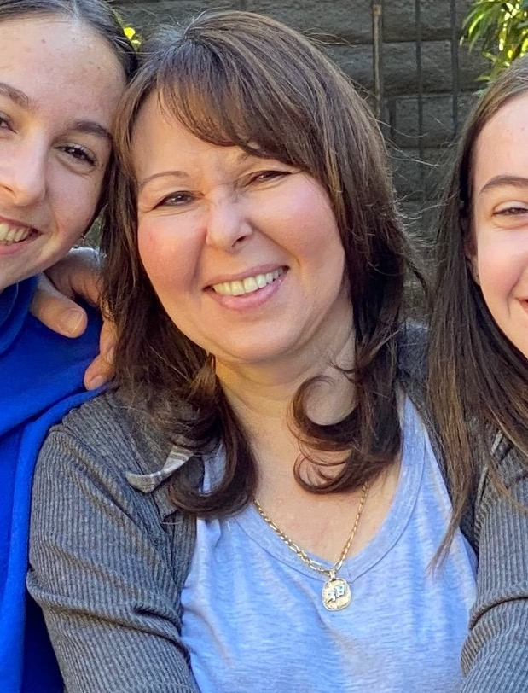
Meet Olga…
Felt like a hamster on a wheel, as tired of not seeing her family and not being able to attend her kids' events on weekends
Making small changes hadn't done anything to get her firm where she wanted it to be
We helped her realize her worth and put herself first
She collected $67,000 in accounts receivable and had wins of $20,000 over what I would have charged or did charge in the prior year, and gets paid upfront for everything
Has the work/life balance she dreamed of having when she started her firm

Slide 38
Getting Paid Upfront is the Fastest Path to Income, Freedom and Peace of Mind
Shift summary/one-liner
This process is the backbone of a successful firm.

Slide 39
Shift summary/one-liner
Money Leak #5:
No Sales System
This process is the backbone of a successful firm.

Slide 40
Be Prepared & Have a SYSTEM
Not having a system in your firm is costing you time, money, stress, AND clients.
Implementing a sales system in your firm allows you to engage your ideal clients and charge fees you’ve never thought were possible to charge
It also allows you to get paid upfront by giving them confidence that you are providing them results they can’t get from anyone else.
Without a system in place, you will end up overworked, underpaid, and burnt out!
When you have a system and a process, you just have to repeat the steps. No more reinventing the wheel with every client!
Notes:
But here is the problem with the old way:
You are seen as a commodity.
You have no idea what your clients really want and need, and they have no idea what you can do for them.
You are burnt out, cranky, & exhausted.
You feel undervalued and underappreciated.
You resent the work you are doing.
Grinding 14 hours a day , ending up burnt out and resenting your work.
Sacrificing time with their family and friends or deferring vacations.

Slide 41
The OLD Way…
The “cross your fingers” method.
Get as many clients as possible, even if they’re not a good fit
Work as much as possible and sacrificing your personal life
Dread tax season, but need it to carry you through the year
Don’t know what to charge, and winging it with each new client
Give discounts or negotiate your fees to get the client
Try to show your expertise with your credentials and jargon
Give free advice & do free work hoping they’ll engage in
the future
Feel burnt out, full of resentment, and wonder if you should just quit

Slide 42
The OLD WAY is costing you time, money, stress AND your ideal clients.

Slide 43
Implementing a sales system in your firm allows you to engage your ideal clients and charge fees you’ve never charged before by giving them confidence that you are providing them results they can’t get from anyone else.
Without a system in place, you will end up overworked, underpaid, and burnt out!

Slide 44
Why You Need a Sales System
No more taking on clients just because you need the money
No more working yourself to death for less than you’re worth & not being appreciated
No more winging your sales conversations or dreading whenever someone asks how much you charge
Having the time and financial freedom to only take on your ideal clients and not have to waste time on anyone else

Slide 45
Be Prepared & Have a SYSTEM
Ask Strategic Questions
Collect
Payment
Prepare/Gather Information
Share & Present
Make the Offer
= A HIGHLY PROFITABLE FIRM full of clients that you LOVE!

Slide 46
Prepare & Gather Information
This is one of the most important steps when it comes to filling your firm with the right clients who will happily pay you up front
YOU are solving a MAJOR problem for your clients and they are are making a huge decision by working with you
Spend AT LEAST 1 hour preparing . You need to know what's going on underneath the surface to get to the root cause of the prospects issues
You should be VERY familiar with the client’s problems so you can have the best solution ready before the meeting and be able to easily anticipate what their potential questions and concerns may be

Slide 47
Ask Strategic, Open-Ended Questions
This helps your clients see the reality of their situation and why they need YOUR help
It builds authority and positions you as the expert
When you get to the REAL pain will show the client that you really understand their problems
This guides the client to a YES on their own so that you won’t have to feel salesy or be pushy.
NO ONE ELSE is asking these questions like this! This simple step sets you apart from everyone else.

Slide 48
Share & Present
Present only HIGH-LEVEL findings of what you found about the client's situation
People don’t care about the details (ex: what forms you’ll fill out) as long as they’re confident you will get them results and you can solve their problems
Focus on the RESULTS and painting a picture of the scenario they’re looking for Relate your recommendations back to their biggest pains and strongest desires
Making things simple to understand will make it easier for the client to make a YES decision (keep techie jargon out of the conversation!)
Give them certainty! “I’m 100% confident I can help you solve X, Y & Z with moving forward with this plan.”

Slide 49
Make the Offer
If you’ve done steps 1-3 the right way, you’ve already led them to a yes and now you just invite them to enroll with you on the spot and wait for their response.
“Let’s get started and review the engagement letter and invoice together right now.”

Slide 50
Collect Payment Upfront
Always be ready to take payment in the first meeting!
“Which credit card or form of payment would you like to use, Amex or Visa, or ACH?”

Slide 51
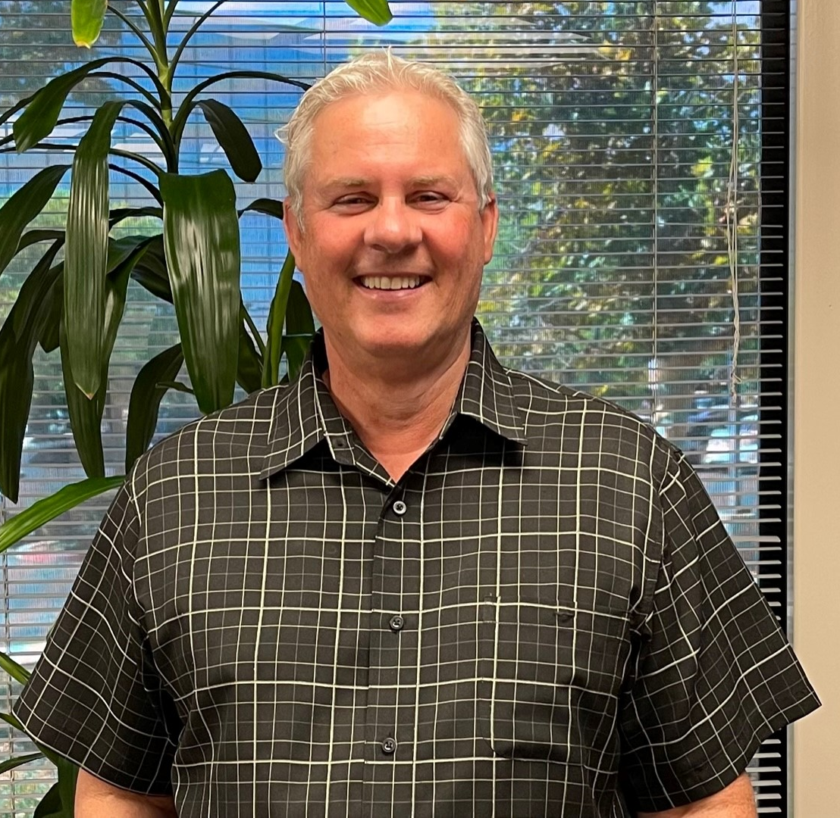
Meet Dennis…
Dennis was overwhelmed, frustrated, and didn’t really like the person that he was becoming
Felt like he had created a job for himself instead of having the firm he’d always dreamed of having
Using this system Dennis was able increase fees for all tax and bookkeeping engagements so he no longer felt underpaid and undervalued
Collected $25k in old A/R in just 8 weeks and will never be chasing people down for money anymore
Dennis
Notes:
Had $25k in AR and collected all but $750 so far. Increased fees, not chasing people down for money anymore and also is OK losing clients
I felt I had created a monster as my firm began overtaking every aspect of my life. I was overwhelmed and frustrated and didn’t really like the person that I was becoming. When I saw the advertisement for The Abundant Accountant and the 8 Week Sales Mastery Training on Facebook I was immediately drawn to it since what was discussed was having a firm that I’d always dreamed of instead of just creating a job for myself. By far the most important change I made was focusing on our outstanding receivables and getting that money in the bank and never wasting another minute of my staff’s time trying to collect what was ours. The major fear that kept cropping up for me was finding the time to devote to the course and whether I would find it interesting and helpful enough to make me stick to it. With the weekly Zoom calls, the collaboration with my staff and the support from Michelle and Denise those fears were gone almost immediately. Within a month I increased our fees from what we would have normally charged for our tax and bookkeeping engagements to the point where I had already paid for the course two-times over and was actually playing with house money! Of all the benefits of taking the course, I would say that the camaraderie with the other classmates and the realization that I was not alone in this journey have had the biggest impact on me and my firm.
~ Dennis Tolliver, Certified Public Accountant

Slide 52
You can eliminate 90% of the time wasting strategies you’ve been doing, and replace it with this step-by-step system.
Shift summary/one-liner
This process is the backbone of a successful firm.

Slide 53
Plug Money Leaks for Good: Invest in Mentoring
As simple as this is, there are a million ways to mess it up.
Why try to figure it out on your own when someone can just hand you the answers?
I have helped over 233 accounting, tax and bookkeeping firm owners quickly grow their firm revenue, eliminate all A/R, all without the stress & burnout.
We turned their firms completely around so that they can actually have relaxed success and go on vacations that they use to only dream about before.

Slide 54
Who Is This For?
You must own a firm that offers higher value services such as tax planning, consulting services, tax resolution, CFO services, profit coaching, bookkeeping and/or accounting services.
You are ready to INVEST now in yourself and your firm for growth
You take complete responsibility for your success, are NOT looking for permission from anyone to upgrade your firm, and are committed to invest your time, money and effort in yourself.
You must be fed up with your approach and ready to learn and apply a completely new way.
If that’s you, book a session now!

Slide 55
My team and I have set aside some time in the next 48 hours to speak to you personally about how you can apply these ideas to your firm starting TODAY.
www.theabundantcall.com

Slide 56
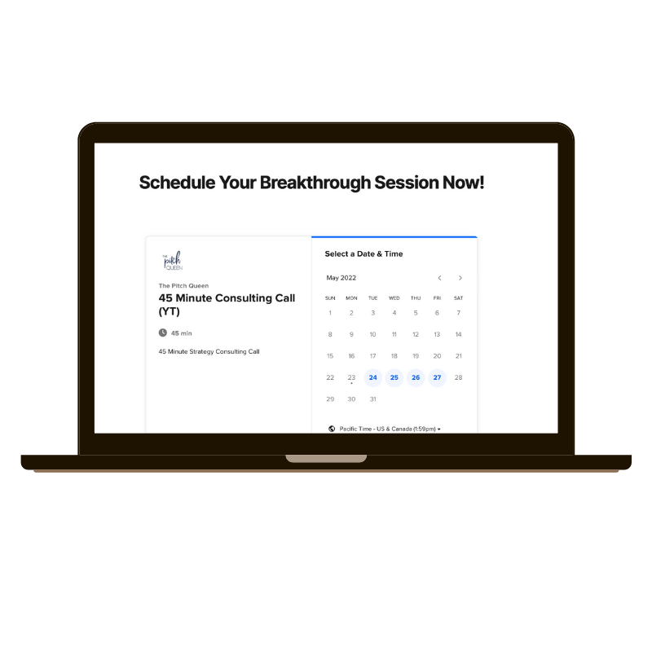
Click Below to Grab Your Spot!
www.theabundantcall.com

Slide 57
Q&A

